Slide 1
Organizational Behavior
Chapter 12 LEADERSHIP

Slide 2
Learning Outcomes
After reading this chapter, you should be able to answer these questions:
What is the nature of leadership and the leadership process?
What are the processes associated with people coming to leadership positions?
How do leaders influence and move their followers to action?
What are the trait perspectives on leadership?
What are the behavioral perspectives on leadership?
What are the situational perspectives on leadership?
What does the concept “substitute for leadership” mean?
What are the characteristics of transactional, transformational, and charismatic leadership?
How do different approaches and styles of leadership impact what is needed now?

Slide 3
1. What is the nature of leadership and the leadership process?
Concept Check
What is the nature of leadership and the leadership process?

Slide 4
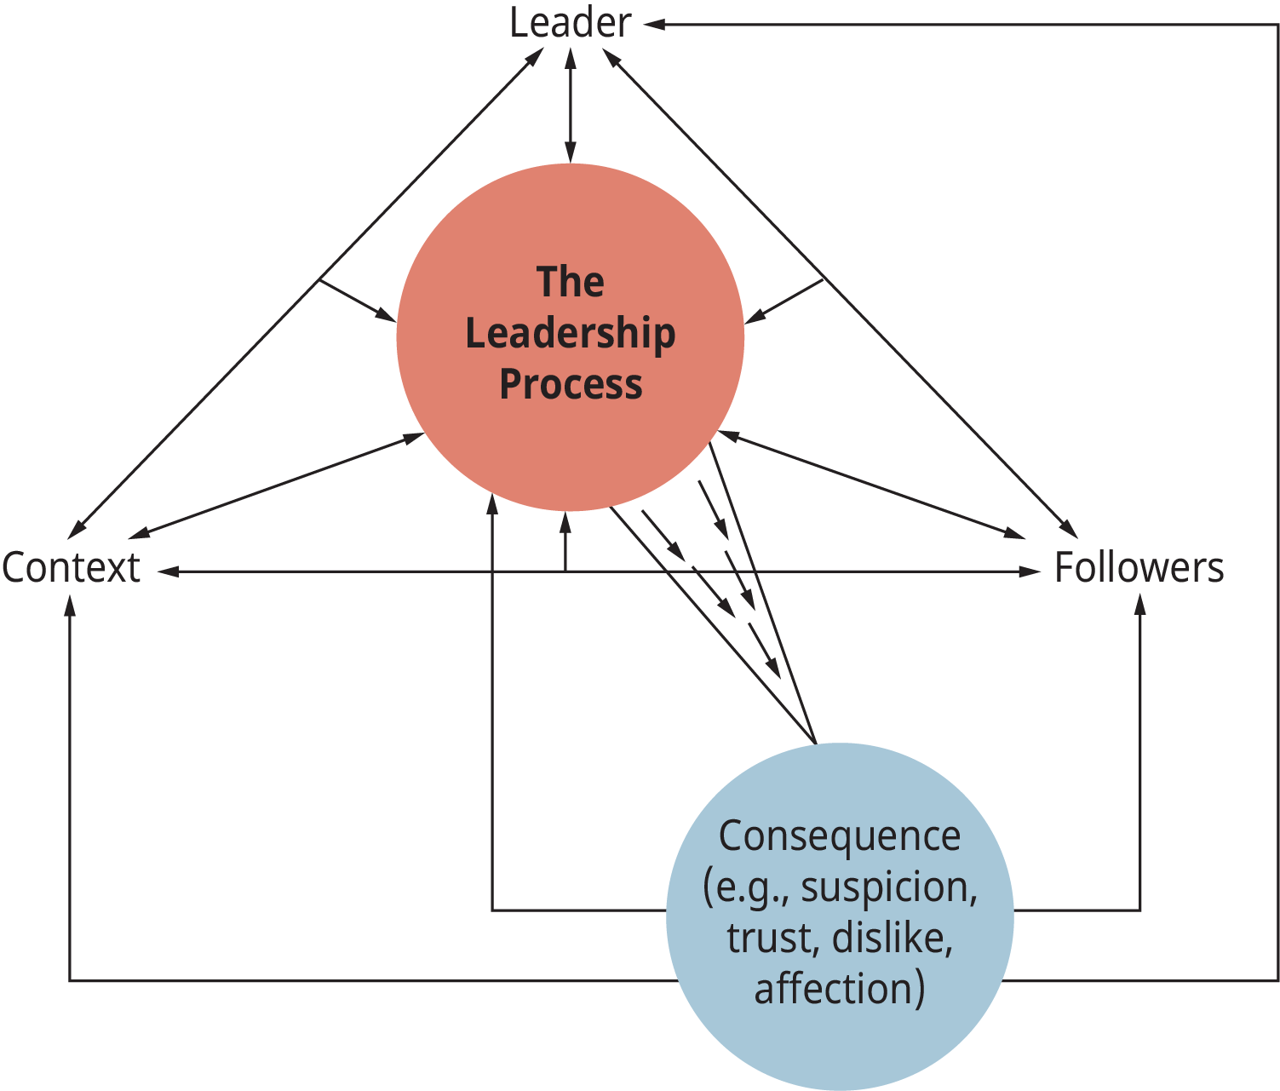
Exhibit 12.3 The Leadership Process
(Attribution: Copyright Rice University, OpenStax, under CC-BY 4.0 license)

Slide 5
2. What are the processes associated with people coming to leadership positions?
Concept Check
What are the processes associated with people coming to leadership positions?

Slide 6
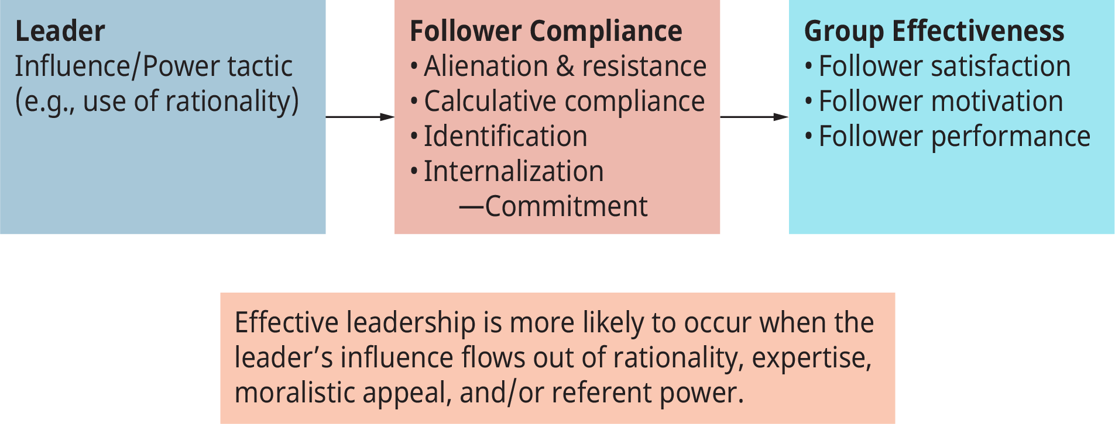
Exhibit 12.5 The Leader-Follower Power Relationship
(Attribution: Copyright Rice University, OpenStax, under CC-BY 4.0 license)

Slide 7
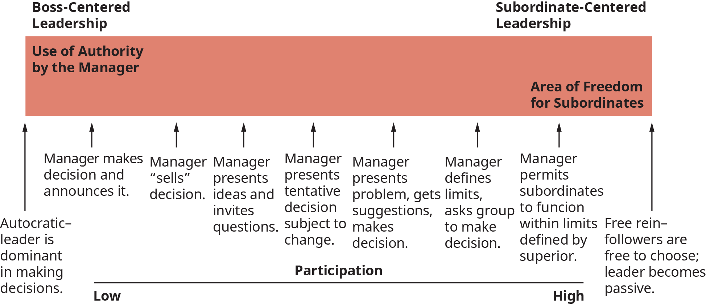
Exhibit 12.6 Tannenbaum and Schmidt’s Leadership Continuum
Source: Modified from R. Tannenbaum and W. H. Schmidt. May—June 1971. How to choose a leadership pattern. Harvard Business Review, 167.

Slide 8
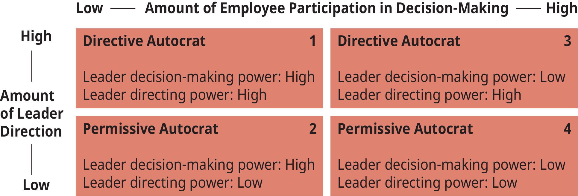
Exhibit 12.7 Leadership Behavior and the Uses of Power
Source: Modified from J. P. Muczyk and B. C. Reimann. 1987. The case for directive leadership. Academy of Management Executive, 1:304.

Slide 9
3. How do leaders influence and move their followers to action?
Concept Check
What is the role of the leader and follower in the leadership process?
How do the theories of Tannenbaum and Schmidt’s leadership continuum and McGregor’s Theory X and Theory Y attempt to define leadership?

Slide 10
4. What are the trait perspectives on leadership?
Concept Check
What are the trait perspectives on leadership?

Slide 11
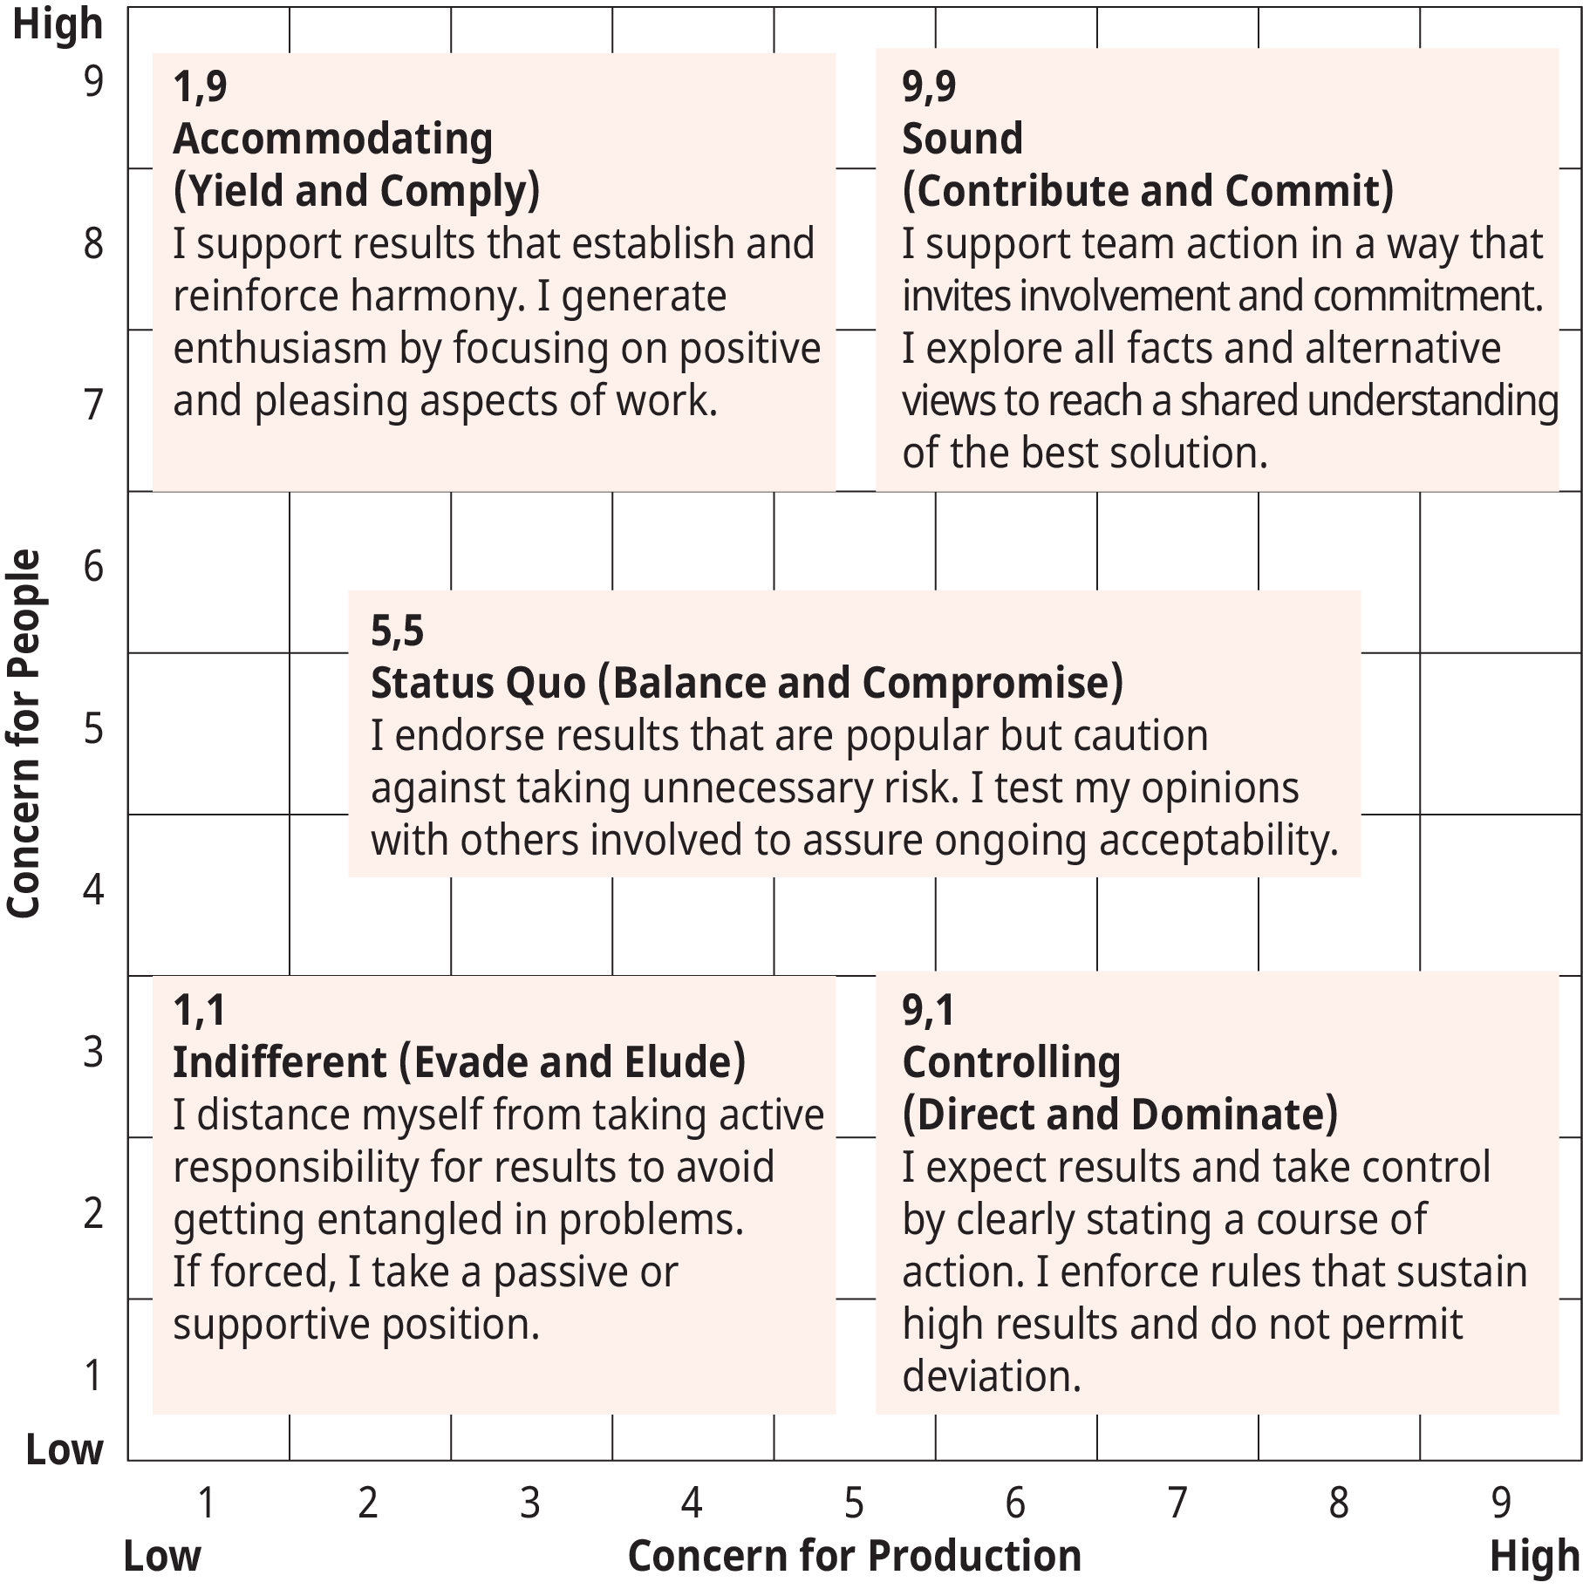
Exhibit 12.9 Blake and Mouton’s Managerial Grid
Source: Adapted from R. McKee and B. Carlson. 1999. The Power to Change, p.16.

Slide 12
5. What are the behavioral perspectives on leadership?
Concept Check
What are the behavioral approaches to defining leadership?
What roles do gender and the popular perceptions of gender roles have on views of leadership traits?

Slide 13
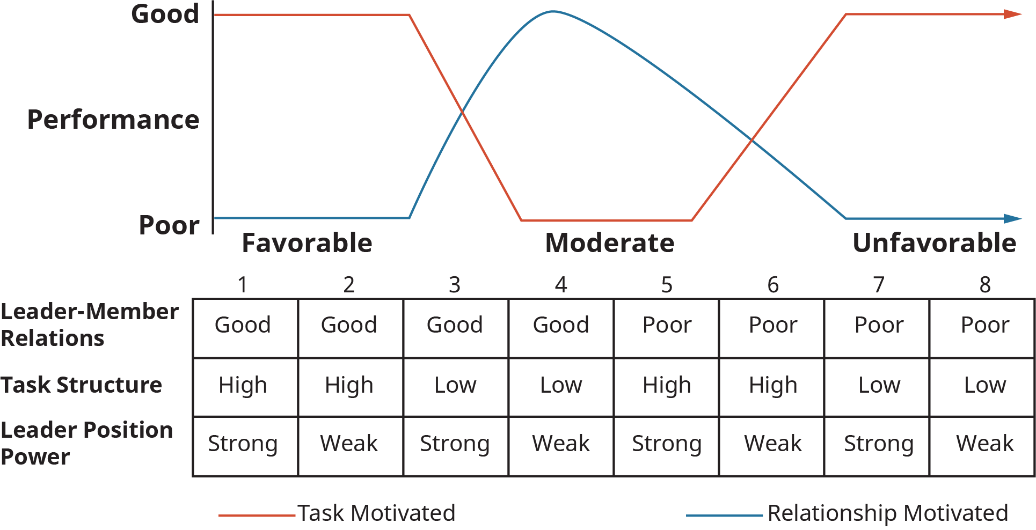
Exhibit 12.10 Fiedler’s Contingency Model of Leader-Situation Matches
Source: Adapted from F. E. Fiedler and M. M. Chemers. 1974. Leadership and effective management. Glenview, IL: Scott, Foresman.

Slide 14
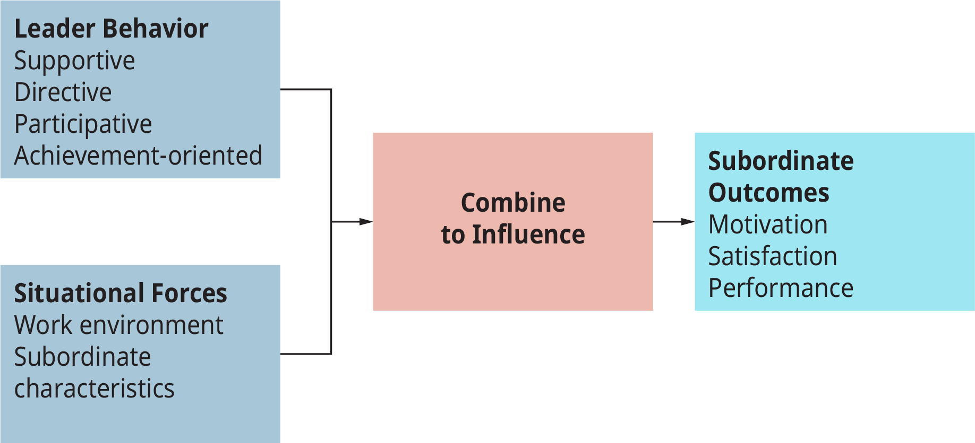
Exhibit 12.11 The Path-Goal Leadership Model
(Attribution: Copyright Rice University, OpenStax, under CC-BY 4.0 license).

Slide 15
6. What are the situational perspectives on leadership?
Concept Check
Identify and describe the variables presented in Fiedler’s theory of leadership.
What are the leadership behaviors in the path-goal theory of leadership?
What role does culture have in how leadership is viewed?
What are the differences between the trait, behavioral, and situational approaches to defining leadership?

Slide 16
Table 12.1 Substitutes for and Neutralizers of Leader Behavior
 |  | Leader | Behavior Influenced
Supportive or Neutralizer |  | Substitute Leadership | Instrumental Leadership
A. Subordinate Characteristics:
 | 1. Experience, ability, training |  | Substitute
 | 2. “Professional” orientation | Substitute | Substitute
 | 3. Indifference toward rewards offered by organization | Neutralizer | Neutralizer
B. Task Characteristics:
 | 1. Structured, routine, unambiguous task |  | Substitute
 | 2. Feedback provided by task |  | Substitute
 | 3. Intrinsically satisfying task | Substitute
C. Organization Characteristics:
 | 1. Cohesive work group | Substitute | Substitute
 | 2. Low position power (leader lacks control over organizational rewards) | Neutralizer | Neutralizer
 | 3. Formalization (explicit plans, goals, areas of responsibility) |  | Substitute
 | 4. Inflexibility (rigid, unyielding rules and procedures) |  | Neutralizer
 | 5. Leader located apart from subordinates with only limited communication possible | Neutralizer | Neutralizer
Source: Adapted from Leadership in organizations by G. A. Yukl.

Slide 17
7. What does the concept “substitute for leadership” mean?
Concept Check
Identify and describe substitutes of leadership.

Slide 18
8. What are the characteristics of transactional, transformational, and charismatic leadership?
Concept Check
What are the defining characteristics of transformational and charismatic leaders?

Slide 19
9. How do different approaches and styles of leadership impact what is needed now?
Concept Check
What is the role of leadership in the 21st century?
This OpenStax ancillary resource is © Rice University under a CC-BY 4.0 International license; it may be reproduced or modified but must be attributed to OpenStax, Rice University and any changes must be noted.

