Slide 1
Organizational Behavior
Chapter 3 PeRCEPTION AND JOB ATTITUDES

Slide 2
Learning Outcomes
After reading this chapter, you should be able to answer these questions:
How do differences in perception affect employee behavior and performance?
How can managers and organizations minimize the negative impact of stereotypes and other barriers to accurate social perception in interpersonal relations?
How do people attribute credit and blame for organizational events?
How can a work environment characterized by positive work attitudes be created and maintained?
How can managers and organizations develop a committed workforce?

Slide 3
Exhibit 3.2 The Process of Perceptual Selectivity
(Attribution: Copyright Rice University, OpenStax, under CC-BY 4.0 license)

Slide 4
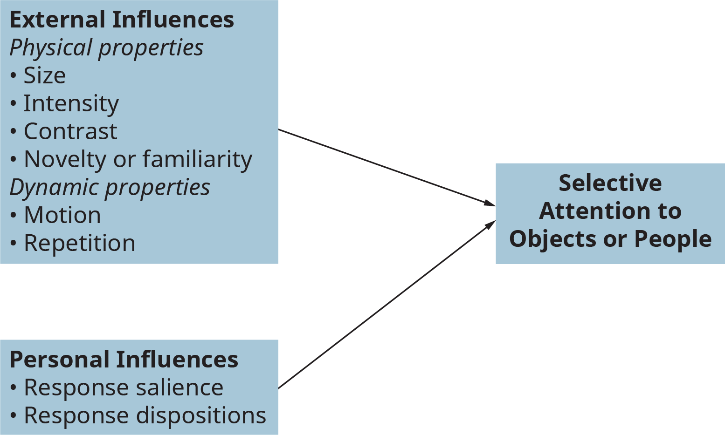
Exhibit 3.3 Major Influences on Selective Attention
(Attribution: Copyright Rice University, OpenStax, under CC-BY 4.0 license)

Slide 5
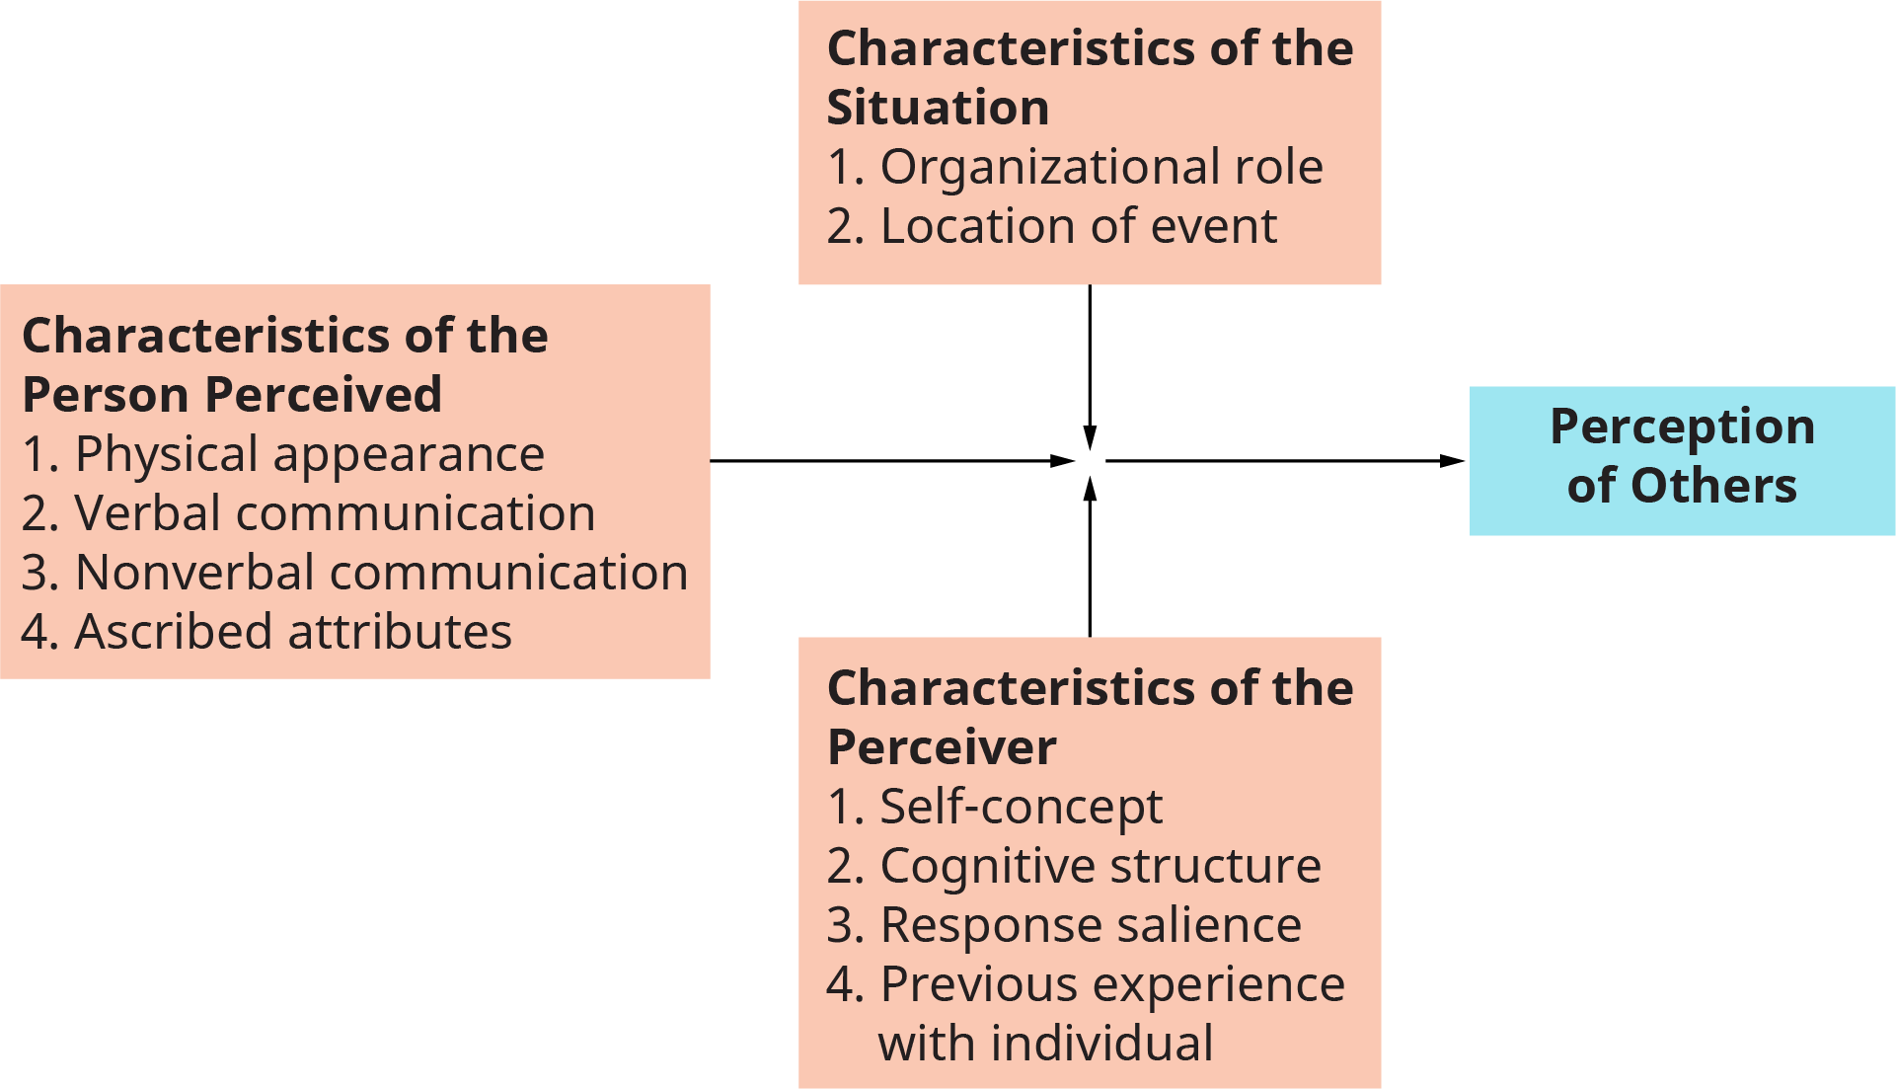
Exhibit 3.4 Major Influences on Social Perception in Organizations
(Attribution: Copyright Rice University, OpenStax, under CC-BY 4.0 license)

Slide 6
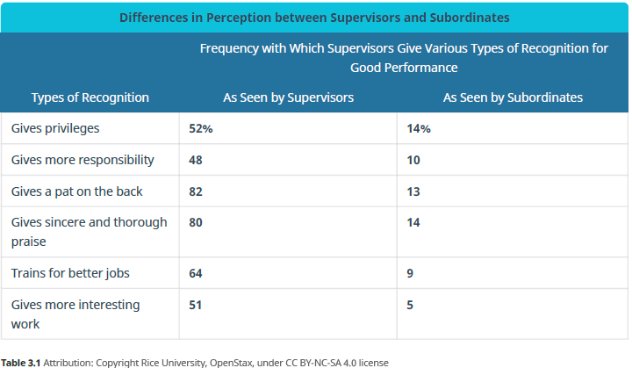
Table 3.1 Differences in Perception Between Supervisors and Subordinates

Slide 7
1. How do differences in perception affect employee behavior and performance?
Concept Check
How can you understand what makes up an individual’s personality?
How does the content of the situation affect the perception of the perceiver?
What are the characteristics that the perceiver can have on interpreting personality?

Slide 8
Table 3.2 Barriers to Accurate Perception of Others

Slide 9
2. How can managers and organizations minimize the negative impact of stereotypes and other barriers to accurate social perception in interpersonal relations?
Concept Check
What are the barriers that can inhibit the accuracy of our perception?
What are the cultural factors that can influence perception?
What is perceptual defense, and what are examples of the mechanisms that can be identified?

Slide 10
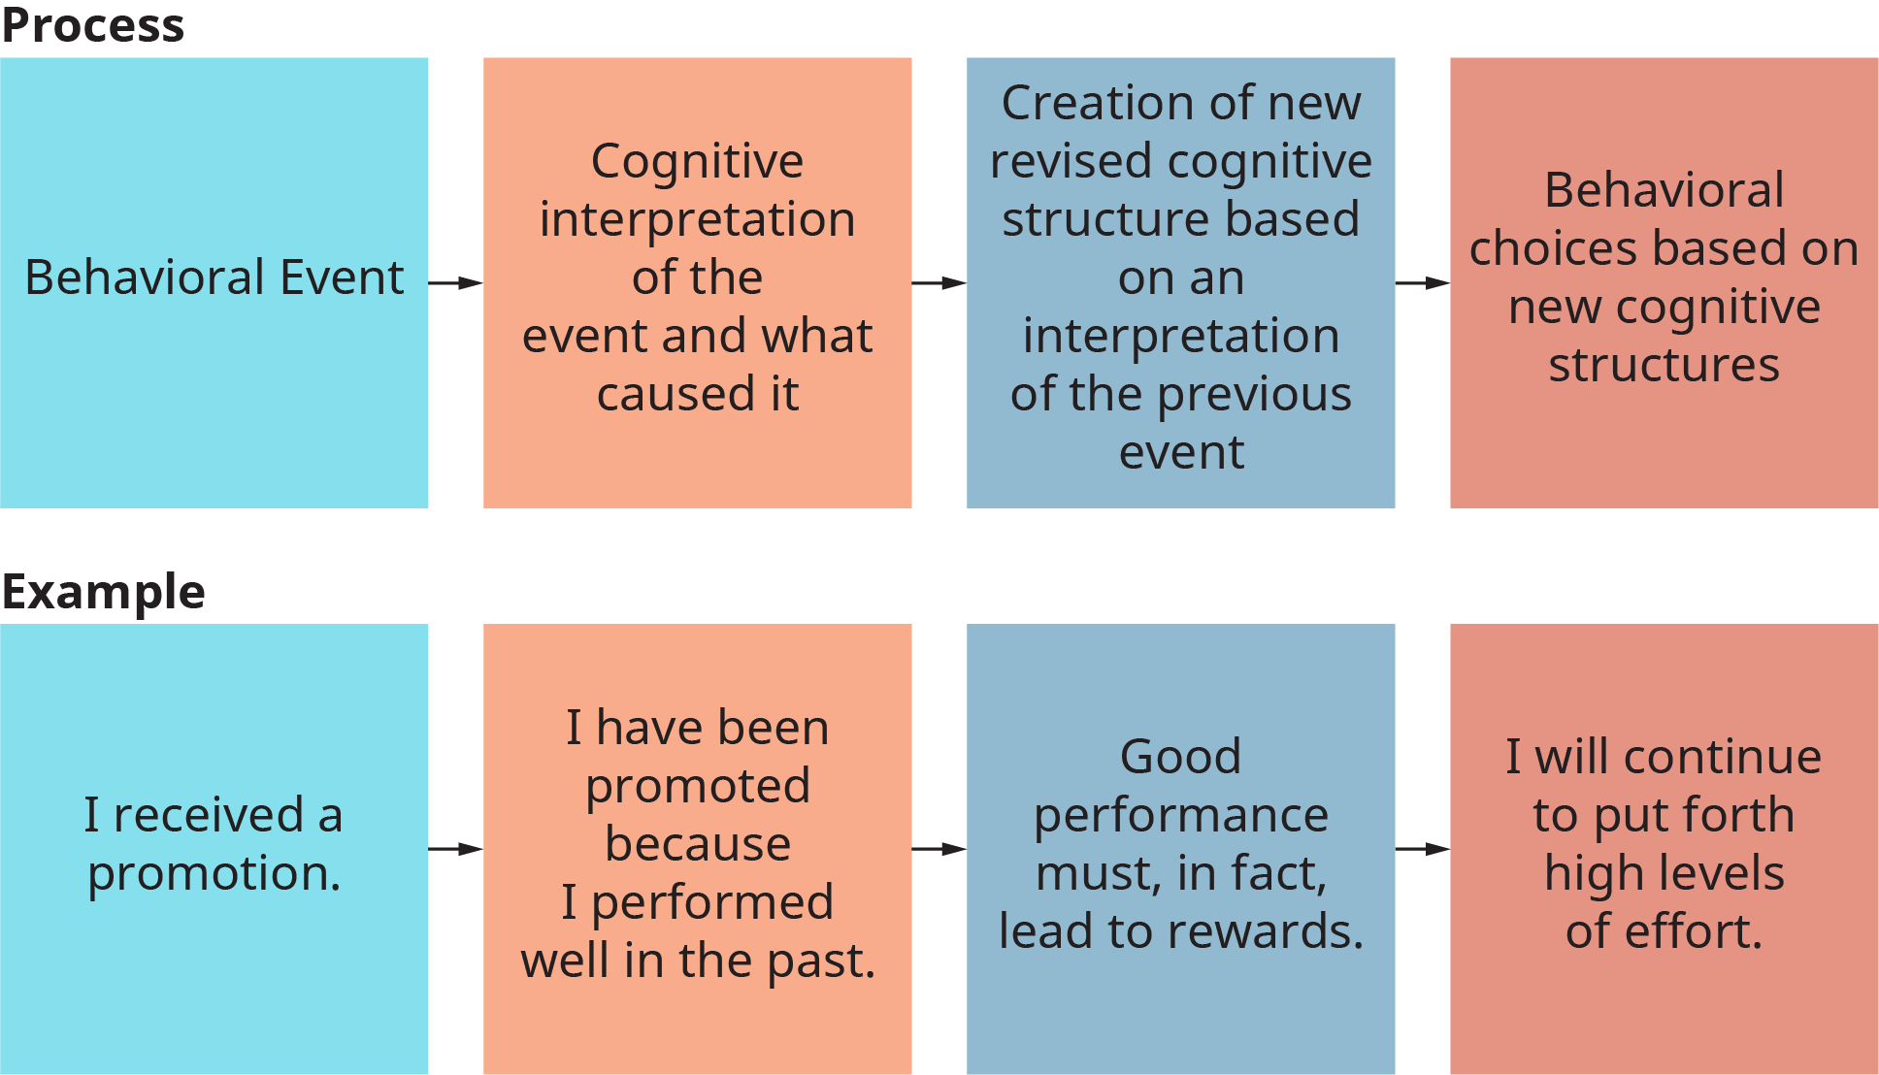
Exhibit 3.5 The General Attribution Process
(Attribution: Copyright Rice University, OpenStax, under CC-BY 4.0 license)

Slide 11
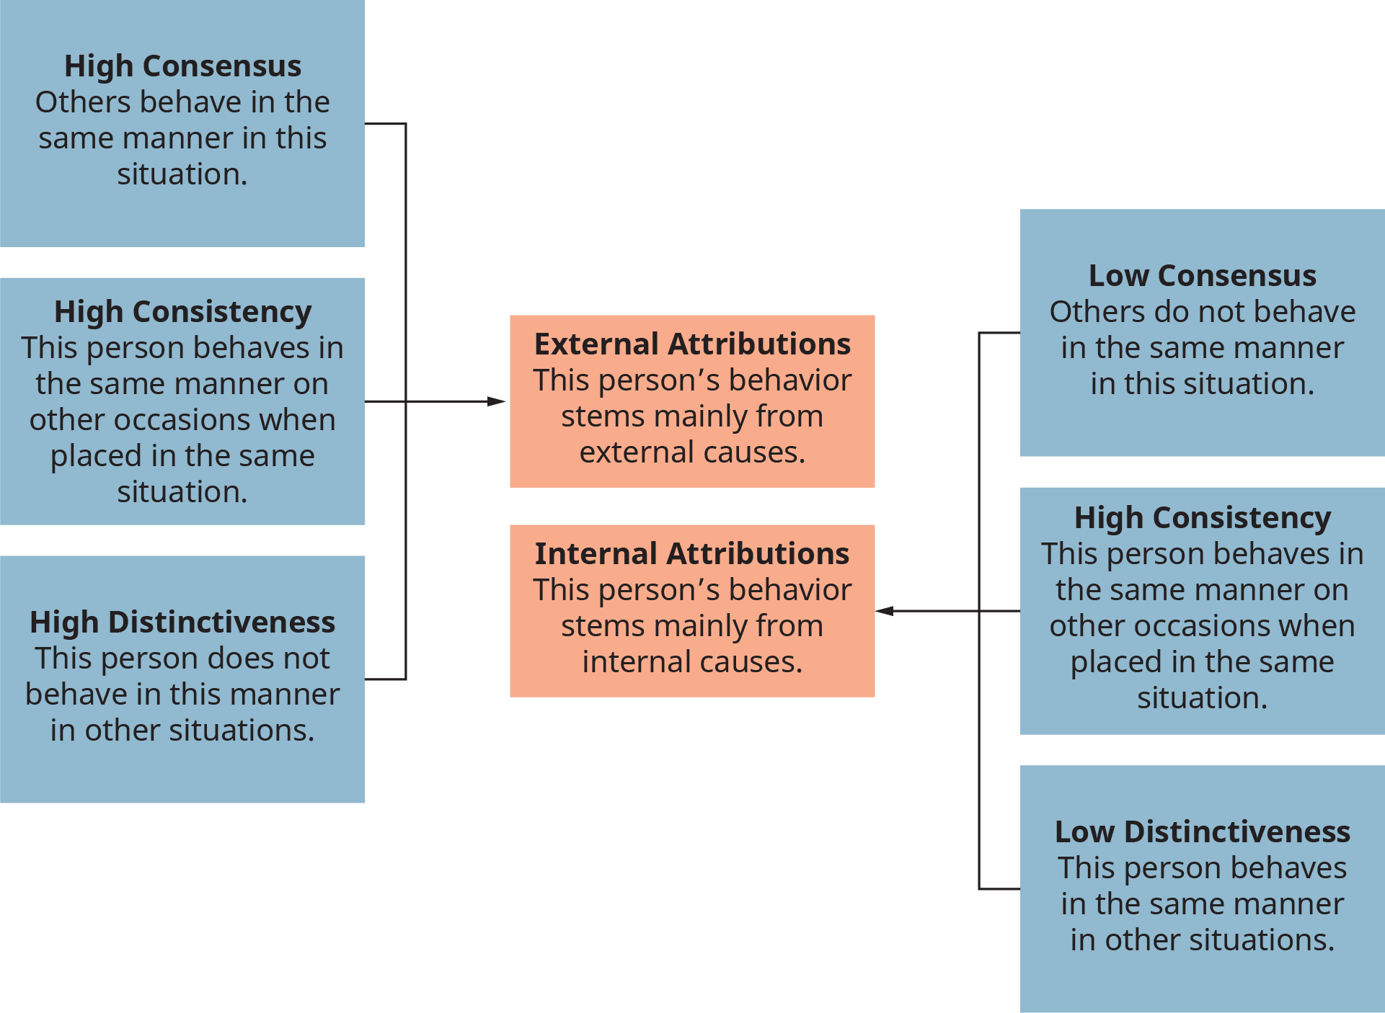
Exhibit 3.6 Causes of Internal and External Attributions
(Attribution: Copyright Rice University, OpenStax, under CC-BY 4.0 license)

Slide 12
3. How do people attribute credit and blame for organizational events?
Concept Check
What is attribution theory? Describe the attribution process.
What are the internal and external causes of attribution?

Slide 13
Exhibit 3.8 Relationship Between Attitudes and Behavior
(Attribution: Copyright Rice University, OpenStax, under CC-BY 4.0 license)

Slide 14
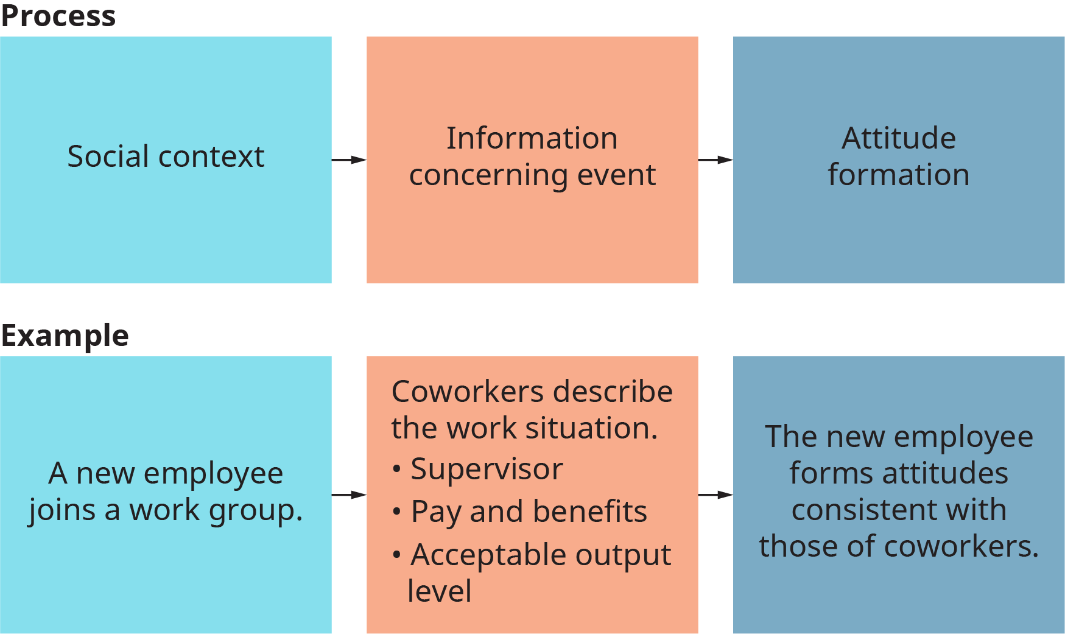
Exhibit 3.9 A Social-Information-Processing View of Attitudes
(Attribution: Copyright Rice University, OpenStax, under CC-BY 4.0 license)

Slide 15
4. How can a work environment characterized by positive work attitudes be created and maintained?
Concept Check
What is attitude, and how does it impact the work environment?
What is behavioral justification?

Slide 16
5. How can managers and organizations develop a committed workforce?
Concept Check
How can organizations foster positive job involvement and instill positive attitudes in their employees?
What are the dimensions of job satisfaction?
This OpenStax ancillary resource is © Rice University under a CC-BY 4.0 International license; it may be reproduced or modified but must be attributed to OpenStax, Rice University and any changes must be noted.

