Slide 1
Organizational Behavior
Chapter 11 COMMUNICATION

Slide 2
Learning Outcomes
After reading this chapter, you should be able to answer these questions:
Understand and describe the communication process.
Know the types of communications that occur in organizations.
Understand how power, status, purpose, and interpersonal skills affect communications in organizations.
Describe how corporate reputations are defined by how an organization communicates to all of its stakeholders.
Know why talking, listening, reading, and writing are vital to managing effectively.

Slide 3
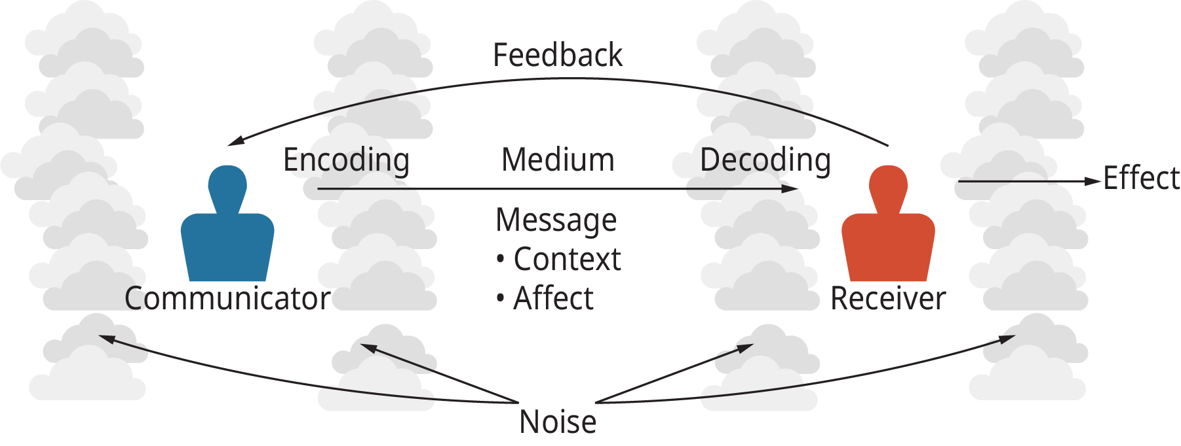
Exhibit 11.2 The Basic Communication Model
(Attribution: Copyright Rice University, OpenStax, under CC-BY 4.0 license)

Slide 4
1. Understand and describe the communication process.
Concept Check
Describe the communication process.
Why is feedback a critical part of the communication process?
What are some things that managers can do to reduce noise in communication?

Slide 5
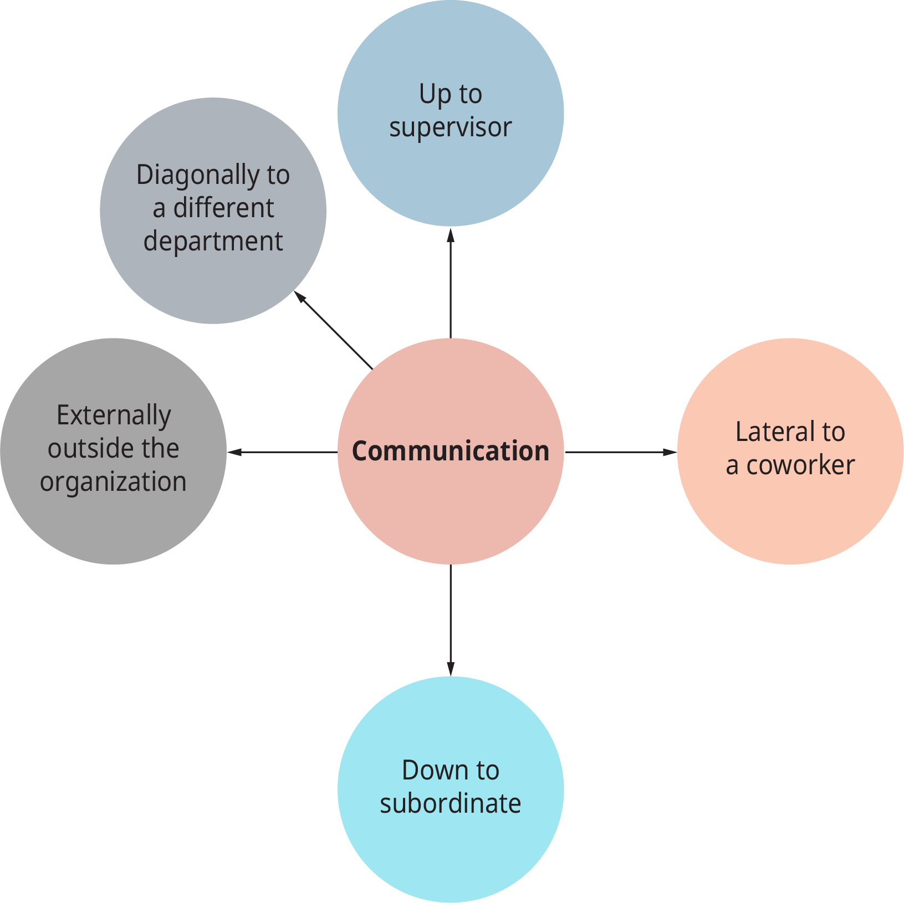
Exhibit 11.4 Patterns of Managerial Communication
(Attribution: Copyright Rice University, OpenStax, under CC-BY 4.0 license)

Slide 6
2. Know the types of communications that occur in organizations.
Concept Check
What are the three major types of communication?
How can you manage the inflow of electronic communication?
What are the major influences on organizational communication, and how can organizational design affect communication?

Slide 7
3. Understand how power, status, purpose, and interpersonal skills affect communications in organizations.
Concept Check
What are the major roles that managers play in communicating with employees?
Why are negotiations often brought in to communications by managers?

Slide 8
4. Describe how corporate reputations are defined by how an organization communicates to its stakeholders.
Concept Check
How are corporate reputations affected by the communication of managers and public statements?
Why is corporate reputation important?

Slide 9
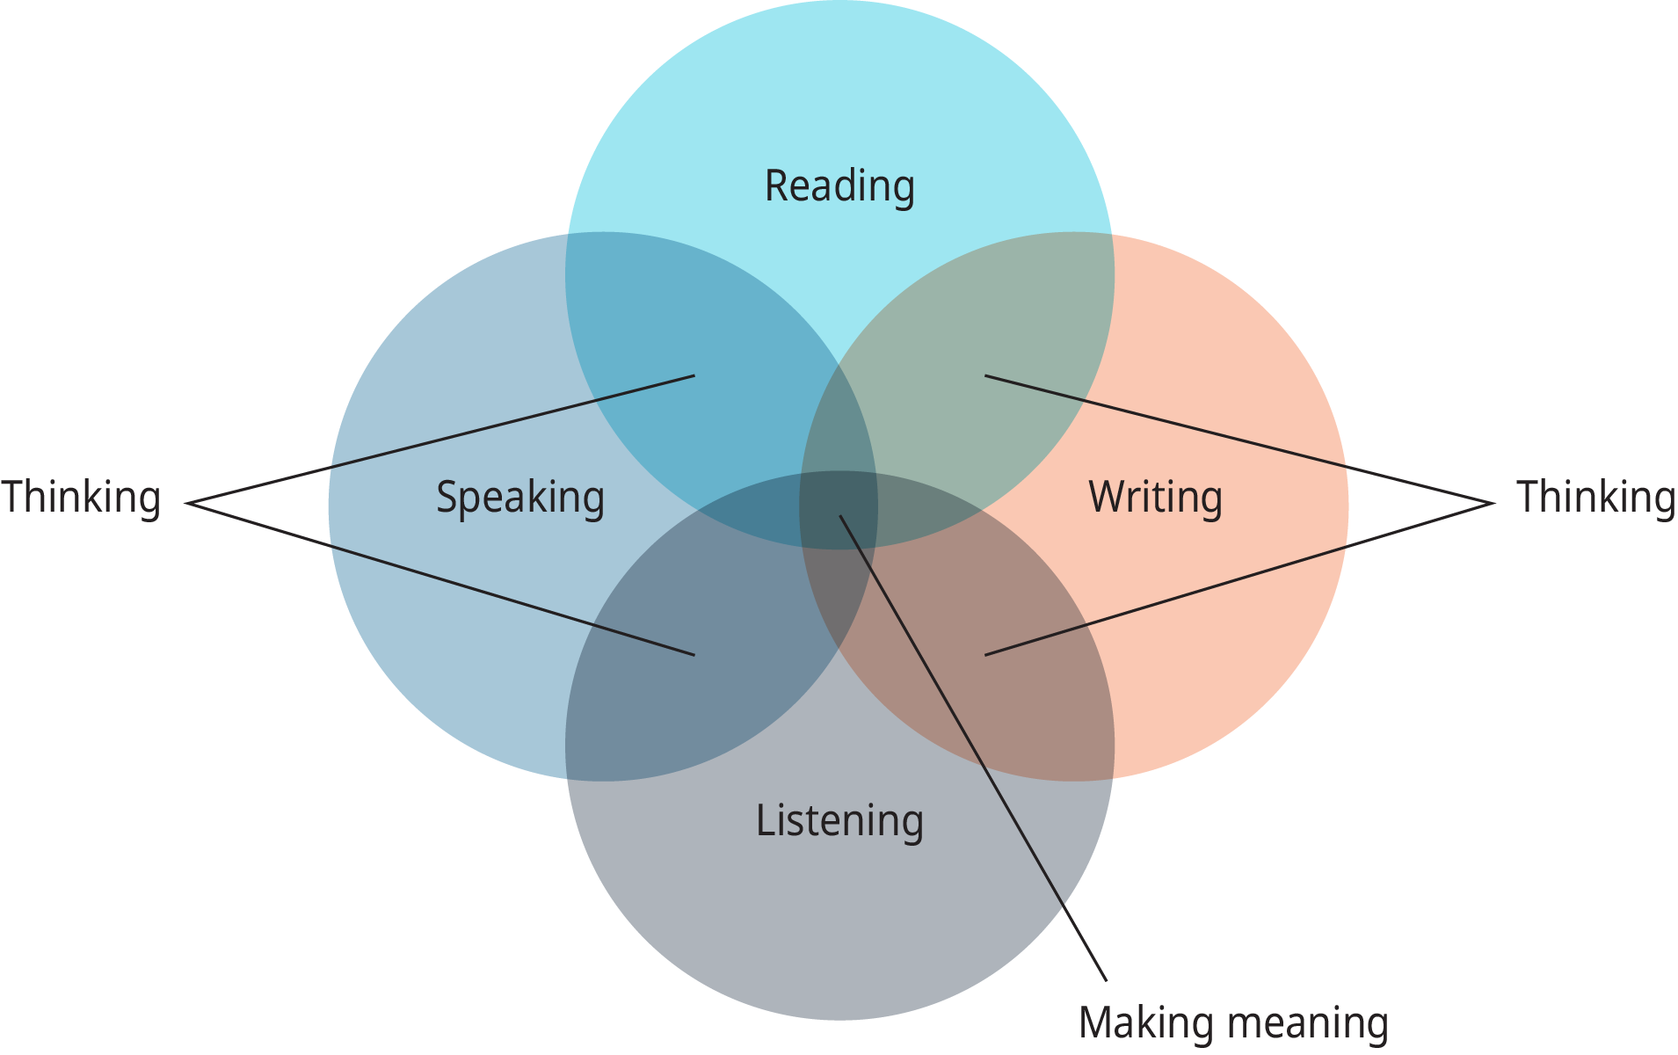
Exhibit 11.6 Reading, Writing, Speaking, and Listening: How They Help in Creating Meaning
(Attribution: Copyright Rice University, OpenStax, under CC-BY 4.0 license)

Slide 10
5. Know why talking, listening, reading, and writing are vital to managing effectively.
Concept Check
What are the four components of communication discussed in this section?
Why is it important to understand your limitations in communicating to others and in larger groups?
Why should managers always strive to improve their skills?
This OpenStax ancillary resource is © Rice University under a CC-BY 4.0 International license; it may be reproduced or modified but must be attributed to OpenStax, Rice University and any changes must be noted.

