Slide 1
Organizational Behavior
Chapter 5 Diversity in Organizations

Slide 2
Learning Outcomes
After reading this chapter, you should be able to answer these questions:
What is diversity?
How diverse is the workforce?
How does diversity impact companies and the workforce?
What is workplace discrimination, and how does it affect different social identity groups?
What key theories help managers understand the benefits and challenges of managing the diverse workforce?
How can managers reap benefits from diversity and mitigate its challenges?
What can organizations do to ensure applicants, employees, and customers from all backgrounds are valued?

Slide 3
Table 5.1 Types of Diversity
Surface-level diversity | Diversity in the form of characteristics of individuals that are readily visible including, but not limited to, age, body size, visible disabilities, race or sex.
Deep-level diversity | Diversity in characteristics that are nonobservable such as attitudes, values, and beliefs, such as religion.
Hidden diversity | Diversity in characteristics that are deep-level but may be concealed or revealed at discretion by individuals who possess them, such as sexual orientation.
(Attribution: Copyright Rice University, OpenStax, under CC-BY 4.0 license)

Slide 4
1. What is diversity?
Concept Check
What is diversity?
What are the three types of diversity encountered in the workplace?

Slide 5
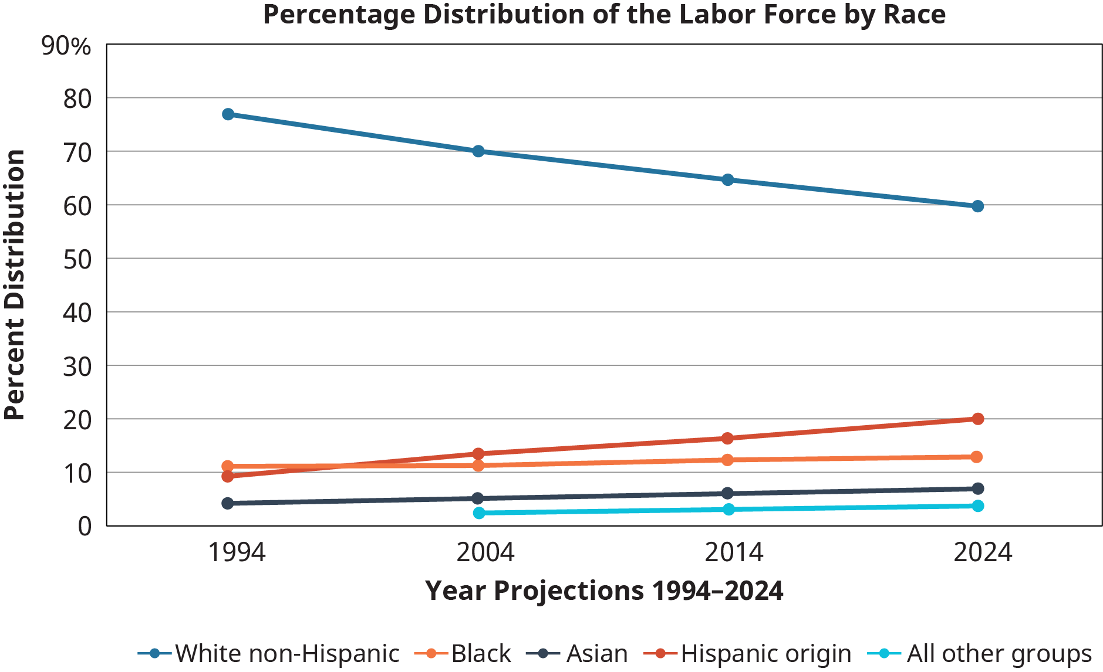
Exhibit 5.2 Percentage distribution of the labor force by race
(Attribution: Copyright Rice University, OpenStax, under CC-BY 4.0 license)

Slide 6
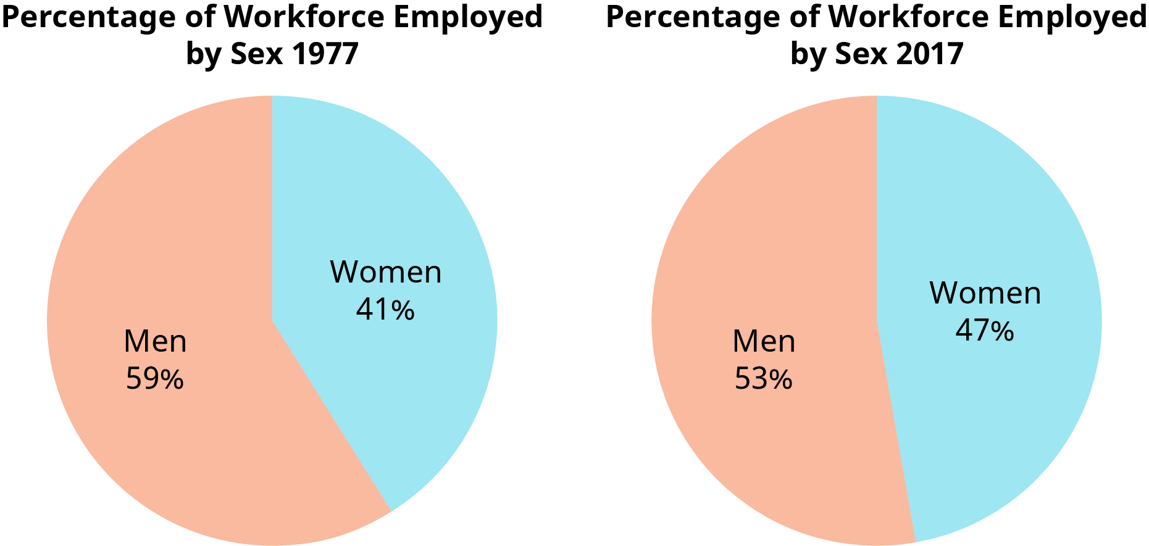
Exhibit 5.3 Percentage Distribution of the Labor Force by Sex
(Attribution: Copyright Rice University, OpenStax, under CC-BY 4.0 license)

Slide 7
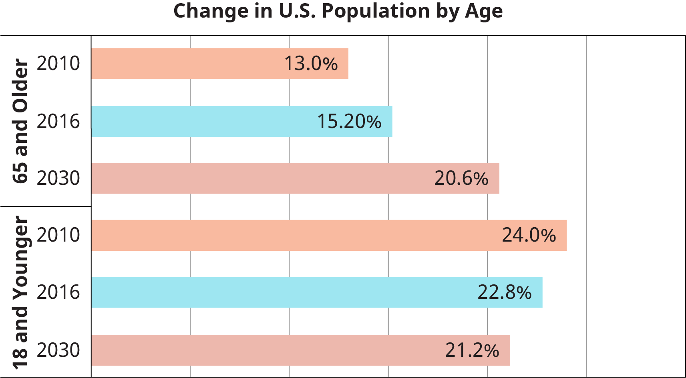
Exhibit 5.5 Change in U.S. population by age
(Attribution: Copyright Rice University, OpenStax, under CC-BY 4.0 license)

Slide 8
2. How diverse is the workforce?
Concept Check
How is diversity defined in relation to the workplace?
What are the components that make up a diverse workplace and workforce?

Slide 9
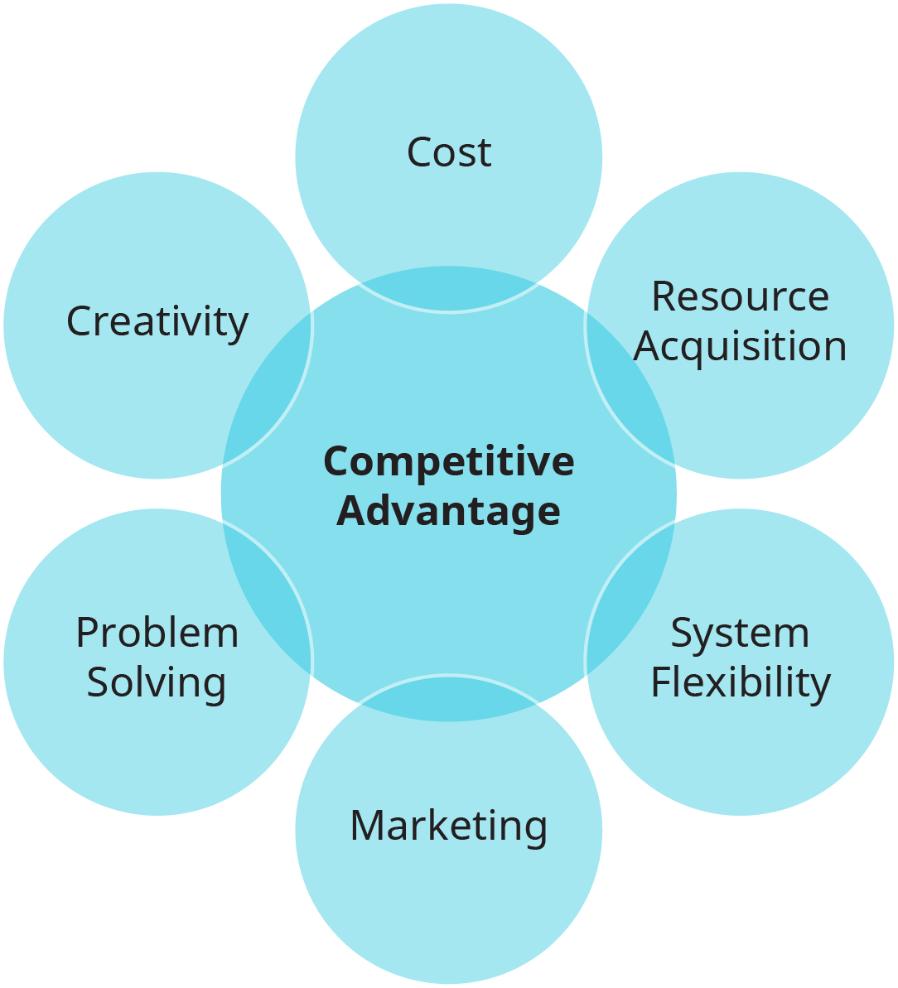
Exhibit 5.6 Managing Cultural Diversity
(Attribution: Copyright Rice University, OpenStax, under CC-BY 4.0 license)

Slide 10
3. How does diversity impact companies and the workforce?
Concept Check
What are the challenges and opportunities that diversity provides to companies?
What are the responsibilities of human resources regarding diversity?
Can diversity be a strategic advantage to organizations?

Slide 11
Table 5.2 Key Diversity Related Legislation
Title VII of the Civil Rights Act of 1964 | Created the Equal Employment Opportunity Commission with the primary role of making it illegal to discriminate against someone in the workplace due to their race, national origin, sex, disability, religion, or pregnancy status.
Equal Pay Act of 1963 | Mandates that men and women must be given the same pay for equal work
Age Discrimination in Employment Act (ADEA) | Forbids discrimination against individuals who are age 40 and above.
Americans with Disabilities Act (ADA) | Prohibits discrimination against people with disabilities in employment, public services, public accommodations, and in telecommunications
Pregnancy Discrimination Act (PDA) | Prohibits any discrimination as it relates to pregnancy, including hiring, firing, compensation, training, job assignment, insurance, or any other employment conditions.
Family and Medical Leave Act (FMLA) | Grants new parents up to 12 weeks of paid or unpaid leave to care for the new child, and gives nursing mothers the right to express milk on workplace premises.
(Attribution: Copyright Rice University, OpenStax, under CC-BY 4.0 license)

Slide 12
4. What is workplace discrimination, and how does it affect different social identity groups?
Concept Check
What is the role of the EEOC?
What are the types of discrimination encountered in the workplace?

Slide 13
5. What key theories help managers understand the benefits and challenges of managing the diverse workforce?
Concept Check
What are the theories that can help managers understand diversity?

Slide 14
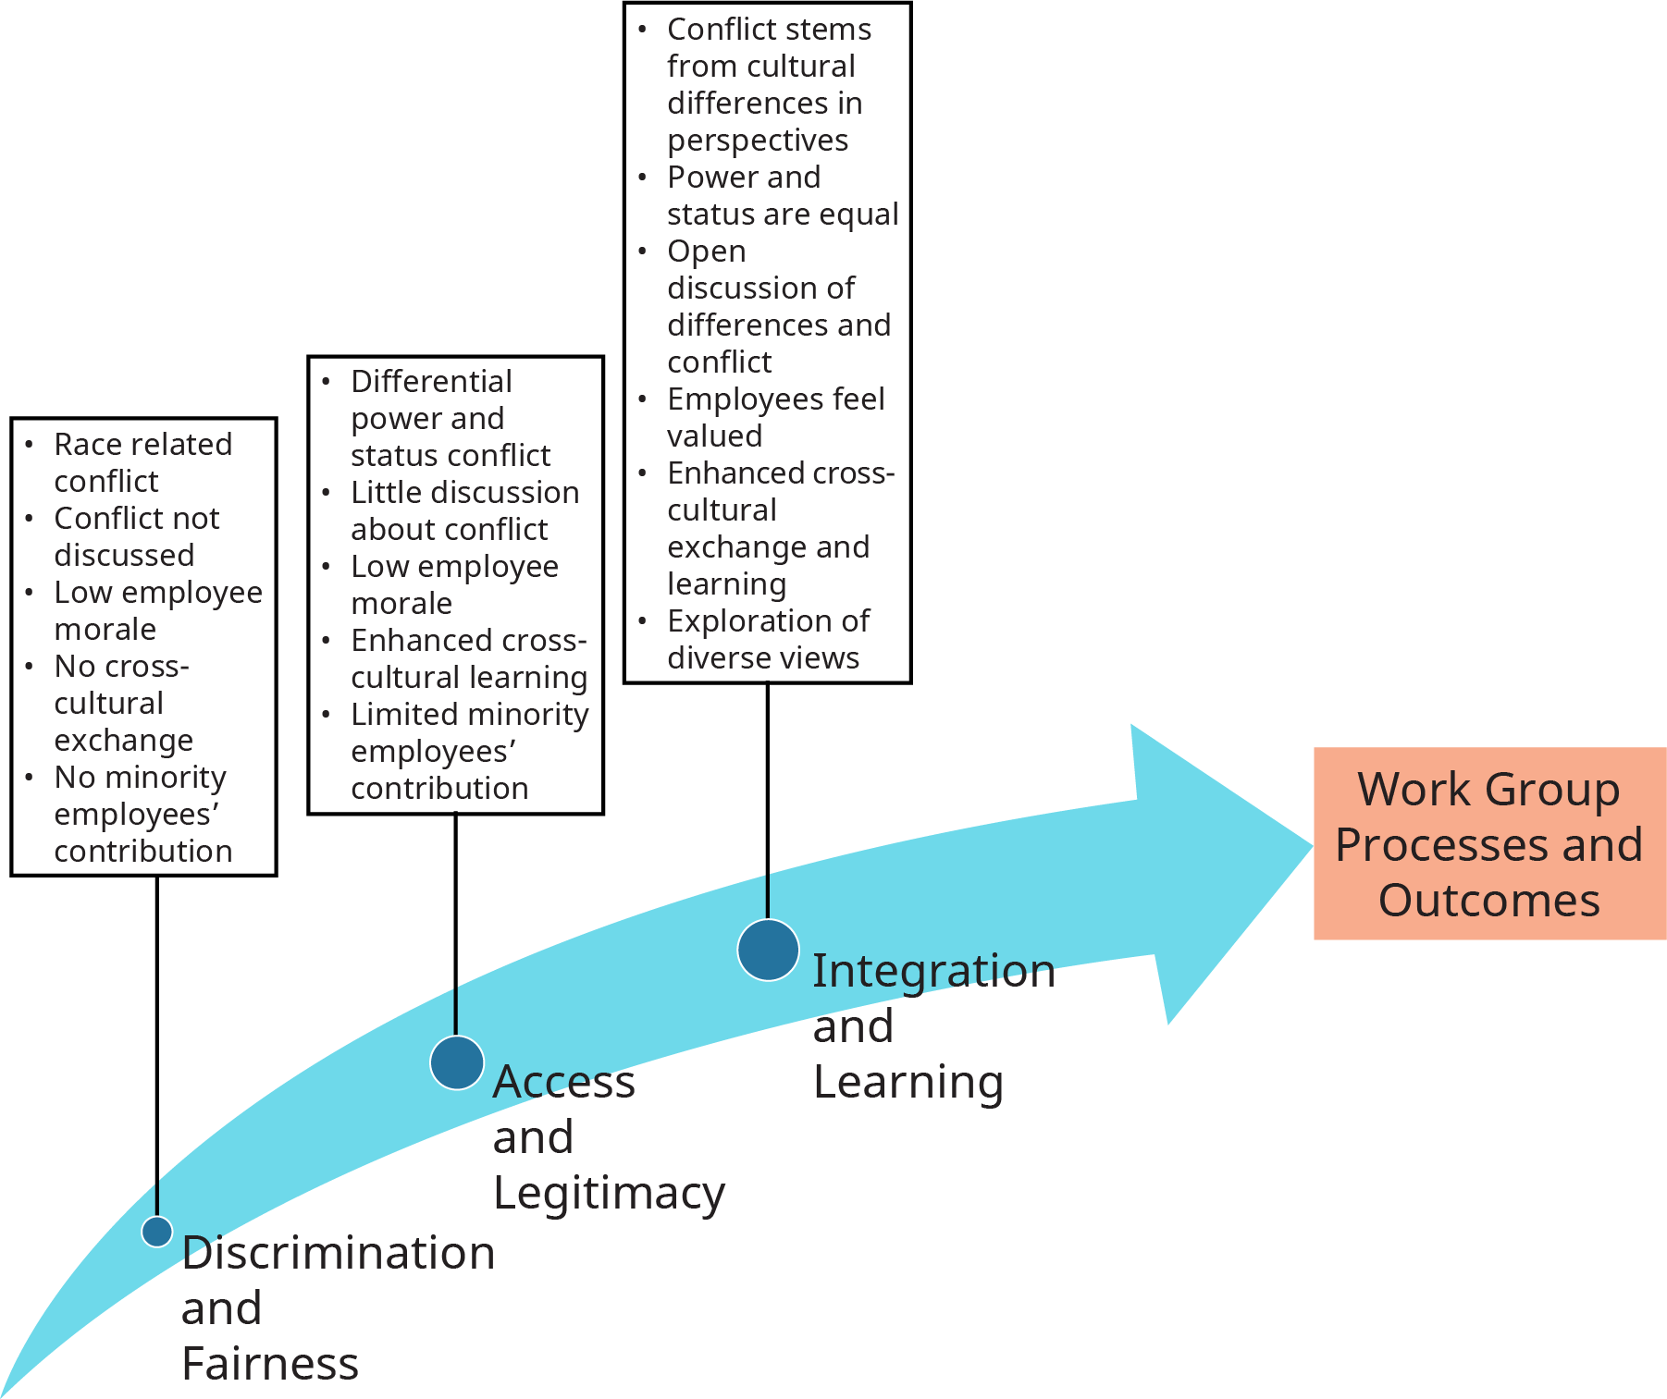
Exhibit 5.8 Cultural Diversity Perspectives at Work
Source: Adapted from Ely, Robin J., and David A. Thomas. “Cultural diversity at work: The effects of diversity perspectives on work group processes and outcomes.” Administrative science quarterly. 46.2 (2001): 229-273.

Slide 15
6. How can managers reap benefits from diversity and mitigate its challenges?
Concept Check
How can managers reap the benefits of diversity?
How can managers mitigate the challenges of diversity?
What is the access-and-legitimacy perspective? Differentiate it from the discrimination-and-fairness perspective.

Slide 16
7. What can organizations do to ensure applicants, employees, and customers from all backgrounds are valued?
Concept Check
How can managers ensure fairness in the interviewing and selection process regarding diversity?
What is the role of leadership regarding diversity?
This OpenStax ancillary resource is © Rice University under a CC-BY 4.0 International license; it may be reproduced or modified but must be attributed to OpenStax, Rice University and any changes must be noted.

