Slide 1
Organizational Behavior
Chapter 6 PERCEPTION AND INDIVIDUAL AND GROUP Decision-Making

Slide 2
Learning Outcomes
After reading this chapter, you should be able to answer these questions:
What are the basic characteristics of managerial decision-making?
What are the two systems of decision-making in the brain?
What is the difference between programmed and nonprogrammed decisions?
What barriers exist that make effective decision-making difficult?
How can a manager improve the quality of her individual decision-making?
What are the advantages and disadvantages of group decision-making, and how can a manager improve the quality of group decision-making?

Slide 3
1. What are the basic characteristics of managerial decision-making?
Concept Check
What are some positive outcomes of decision-making for an organization? What are some possible negative outcomes?
How is managerial decision-making different from a multiple-choice test?
In addition to the owners of a business, who are some of the other stakeholders that managers should consider when making decisions?

Slide 4
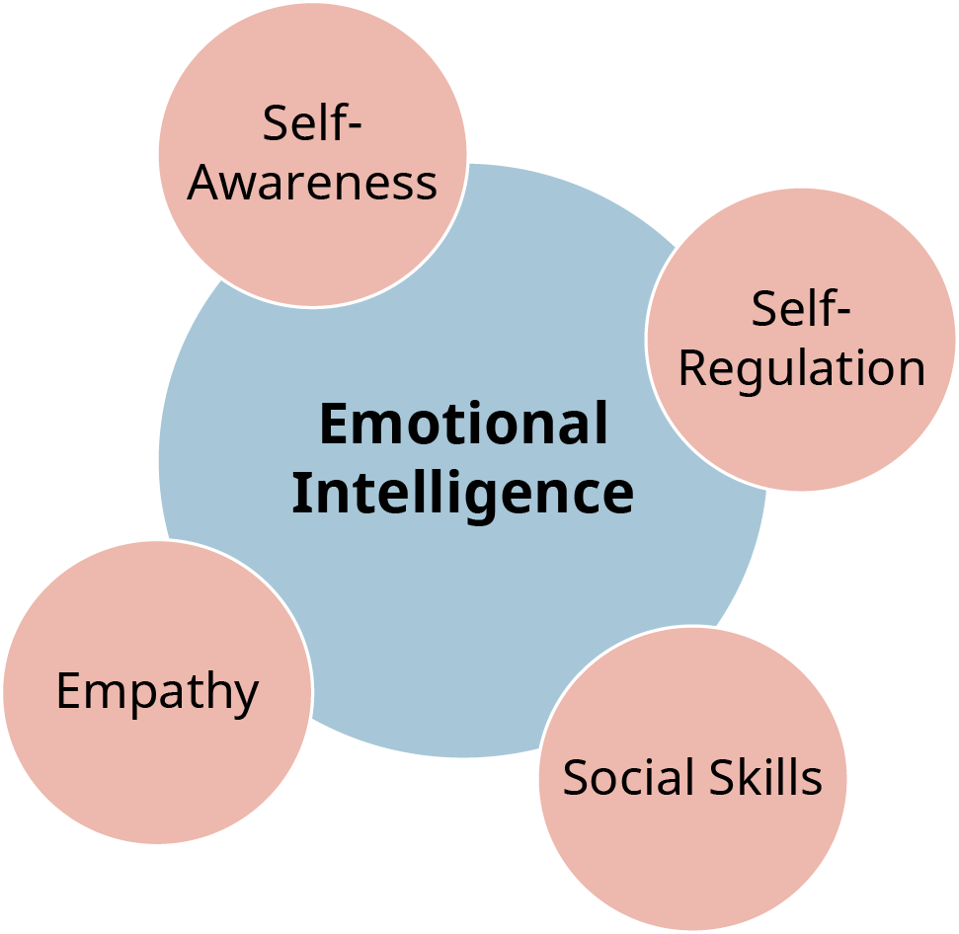
Exhibit 6.2 Emotional Intelligence
(Attribution: Copyright Rice University, OpenStax, under CC-BY 4.0 license)

Slide 5
2. What are the two systems of decision-making in the brain?
Concept Check
Explain the two systems used by the brain in decision-making.
What is emotional intelligence, and why is it important for decision-making?

Slide 6
Exhibit 6.3 High-Involvement and Low-Involvement Decisions.
(Attribution: Copyright Rice University, OpenStax, under CC-BY 4.0 license)

Slide 7
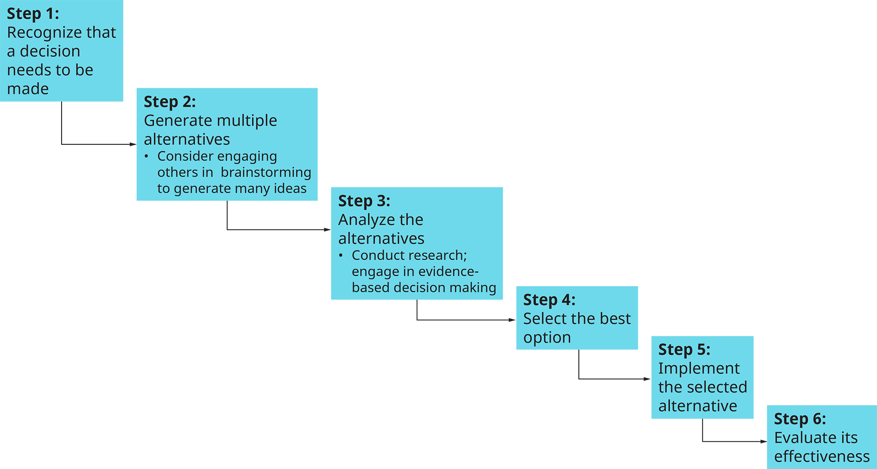
Exhibit 6.4 The Decision-Making Process.
(Attribution: Copyright Rice University, OpenStax, under CC-BY 4.0 license)

Slide 8
3. What is the difference between programmed and nonprogrammed decisions?
Concept Check
Give an example of a programmed decision that a manager might face.
Give an example of a nonprogrammed decision.
What are heuristics, and when are they helpful?
How are programmed and nonprogrammed decisions connected to the reflective and reactive systems in the brain?

Slide 9
4. What barriers exist that make effective decision-making difficult?
Concept Check
Explain the concept of confirmation bias.
List and describe at least three barriers to effective decision-making.
When is conflict beneficial, and when is it harmful? Why?

Slide 10
Table 6.1 Summary of Techniques That May Improve Individual Decision-Making
Type of Decision | Technique | Benefit
Programmed decisions | Heuristics (mental shortcuts) | Saves time
 | Satisficing (choosing first acceptable solution) | Saves time
Nonprogrammed decisions | Systematically go through the six steps of the decision-making process. | Improves quality
 | Talk to other people. | Improves quality: generates more options, reduces bias
 | Be creative. | Improves quality: generates more options
 | Conduct research; engage in evidence-based decision-making. | Improves quality
 | Engage in critical thinking. | Improves quality
 | Think about the long-term implications. | Improves quality
 | Consider the ethical implications. | Improves quality
(Attribution: Copyright Rice University, OpenStax, under CC-BY 4.0 license)

Slide 11
Table 6.2 Common Logical Fallacies
Name | Description | Examples | Ways to Combat This Logical Fallacy
Non sequitur (does not follow) | The conclusion that is presented isn’t a logical conclusion or isn’t the only logical conclusion based on the argument(s). | Our biggest competitor is spending more on marketing than we are. They have a larger share of the market. Therefore, we should spend more on marketing. The unspoken assumption: They have a larger share of the market BECAUSE they spend more on marketing. | Examine all the arguments. Are they reasonable? Look for any assumptions that are being made in the argument sequence. Are they reasonable? Try to gather evidence that supports or refutes the arguments and/or assumptions. In this example, you should ask: Are there any other reasons, besides their spending on marketing, why our competitor has a larger share of the market?
False cause | Assuming that because two things are related, one caused the other | “Our employees get sick more when we close for holidays. So we should stop closing for holidays.” | This is similar to non sequitur; it makes an assumption in the argument sequence. Ask yourself whether the first thing really causes the second, or if something else may be the cause. In this case, most holidays for which businesses close are in the late fall and winter (Thanksgiving, Christmas), and there are more illnesses at this time of year because of the weather, not because of the business being closed.
Ad hominem (attack the man) | Redirects from the argument itself to attack the person making the argument | “You aren’t really going to take John seriously, are you? I heard his biggest client just dropped him for another vendor because he’s all talk and no substance.” The goal: if you stop trusting the person, you’ll discount their argument. | Does the second person have something to gain, a hidden agenda, in trying to make you distrust the first person? If the first person’s argument came from someone else, would it be persuasive?
Genetic fallacy | You can’t trust something because of its origins. | “This was made in China, so it must be low quality.” “He is a lawyer, so you can’t trust anything he says.” | This fallacy is based on stereotypes. Stereotypes are generalizations; some are grossly inaccurate, and even those that are accurate in SOME cases are never accurate in ALL cases. Recognize this for what it is—an attempt to prey on existing biases.
(Attribution: Copyright Rice University, OpenStax, under CC-BY 4.0 license)

Slide 12
Table 6.2 Common Logical Fallacies
Name | Description | Examples | Ways to Combat This Logical Fallacy
Appeal to tradition | If we have always done it one particular way, that must be the right or best way. | “We’ve always done it this way.” “We shouldn’t change this; it works fine the way it is.” | Consider whether the situation has changed, calling for a change in the way things are being done. Consider whether new information suggests that the traditional viewpoint is incorrect. Remember, we used to think that the earth was flat.
Bandwagon approach | If the majority of people are doing it, it must be good. | “Everybody does it.” “Our customers don’t want to be served by people like that.” | Remember that the majority is sometimes wrong, and what is popular isn’t always what is right. Ask yourself whether “following the pack” is going to get you where you want to be. Remember that organizations are usually successful by being better than their competitors at something . . . so following the crowd might not be the best approach to success.
Appeal to emotion | Redirects the argument from logic to emotion | “We should do it for [recently deceased] Steve; it’s what he would have wanted.” | Develop your awareness of your own emotions, and recognize when someone is trying to use them. Ask yourself whether the argument stands on its own without the appeal to your emotions.
(Attribution: Copyright Rice University, OpenStax, under CC-BY 4.0 license)

Slide 13
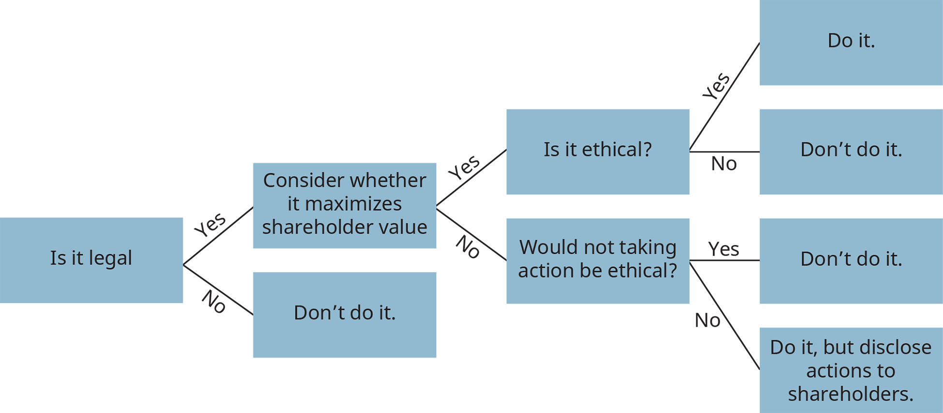
Exhibit 6.6 Ethical Decision Tree
(Attribution: Copyright Rice University, OpenStax, under CC-BY 4.0 license)

Slide 14
5. How can a manager improve the quality of her individual decision-making?
Concept Check
Explain what satisficing is and when it may be a good strategy.
What are the six steps in the decision-making process?
What are the four steps involved in ethical decision-making?

Slide 15
Table 6.3 Summary of Techniques That May Improve Group Decision-Making
Type of Decision | Technique | Benefit
Group decisions | Have diverse members in the group. | Improves quality: generates more options, reduces bias
 | Assign a devil’s advocate. | Improves quality: reduces groupthink
 | Encourage everyone to speak up and contribute. | Improves quality: generates more options, prevents suppression of dissent
 | Help group members find common ground. | Improves quality: reduces personality conflict
(Attribution: Copyright Rice University, OpenStax, under CC-BY 4.0 license)

Slide 16
6. How can a manager improve the quality of her individual decision-making?
Concept Check
Explain why group decision-making can be more effective than individual decision-making.
What are some things that can prevent groups from making good decisions?
As a manager, what can you do to enhance the quality of group decision-making?
This OpenStax ancillary resource is © Rice University under a CC-BY 4.0 International license; it may be reproduced or modified but must be attributed to OpenStax, Rice University and any changes must be noted.

