Slide 1
Organizational Behavior
Chapter 4 LEARNING AND REINFORCEMENT

Slide 2
Learning Outcomes
After reading this chapter, you should be able to answer these questions:
How do organizations offer appropriate rewards in a timely fashion?
What are the best practices that organizations utilize to train employees in new job skills?
How do managers and organizations reduce undesirable employee behavior while reinforcing desirable behavior?
How can employees be trained to assume more responsibility for self-improvement and job performance with the goal of creating a work environment characterized by continual self-learning and employee development?

Slide 3
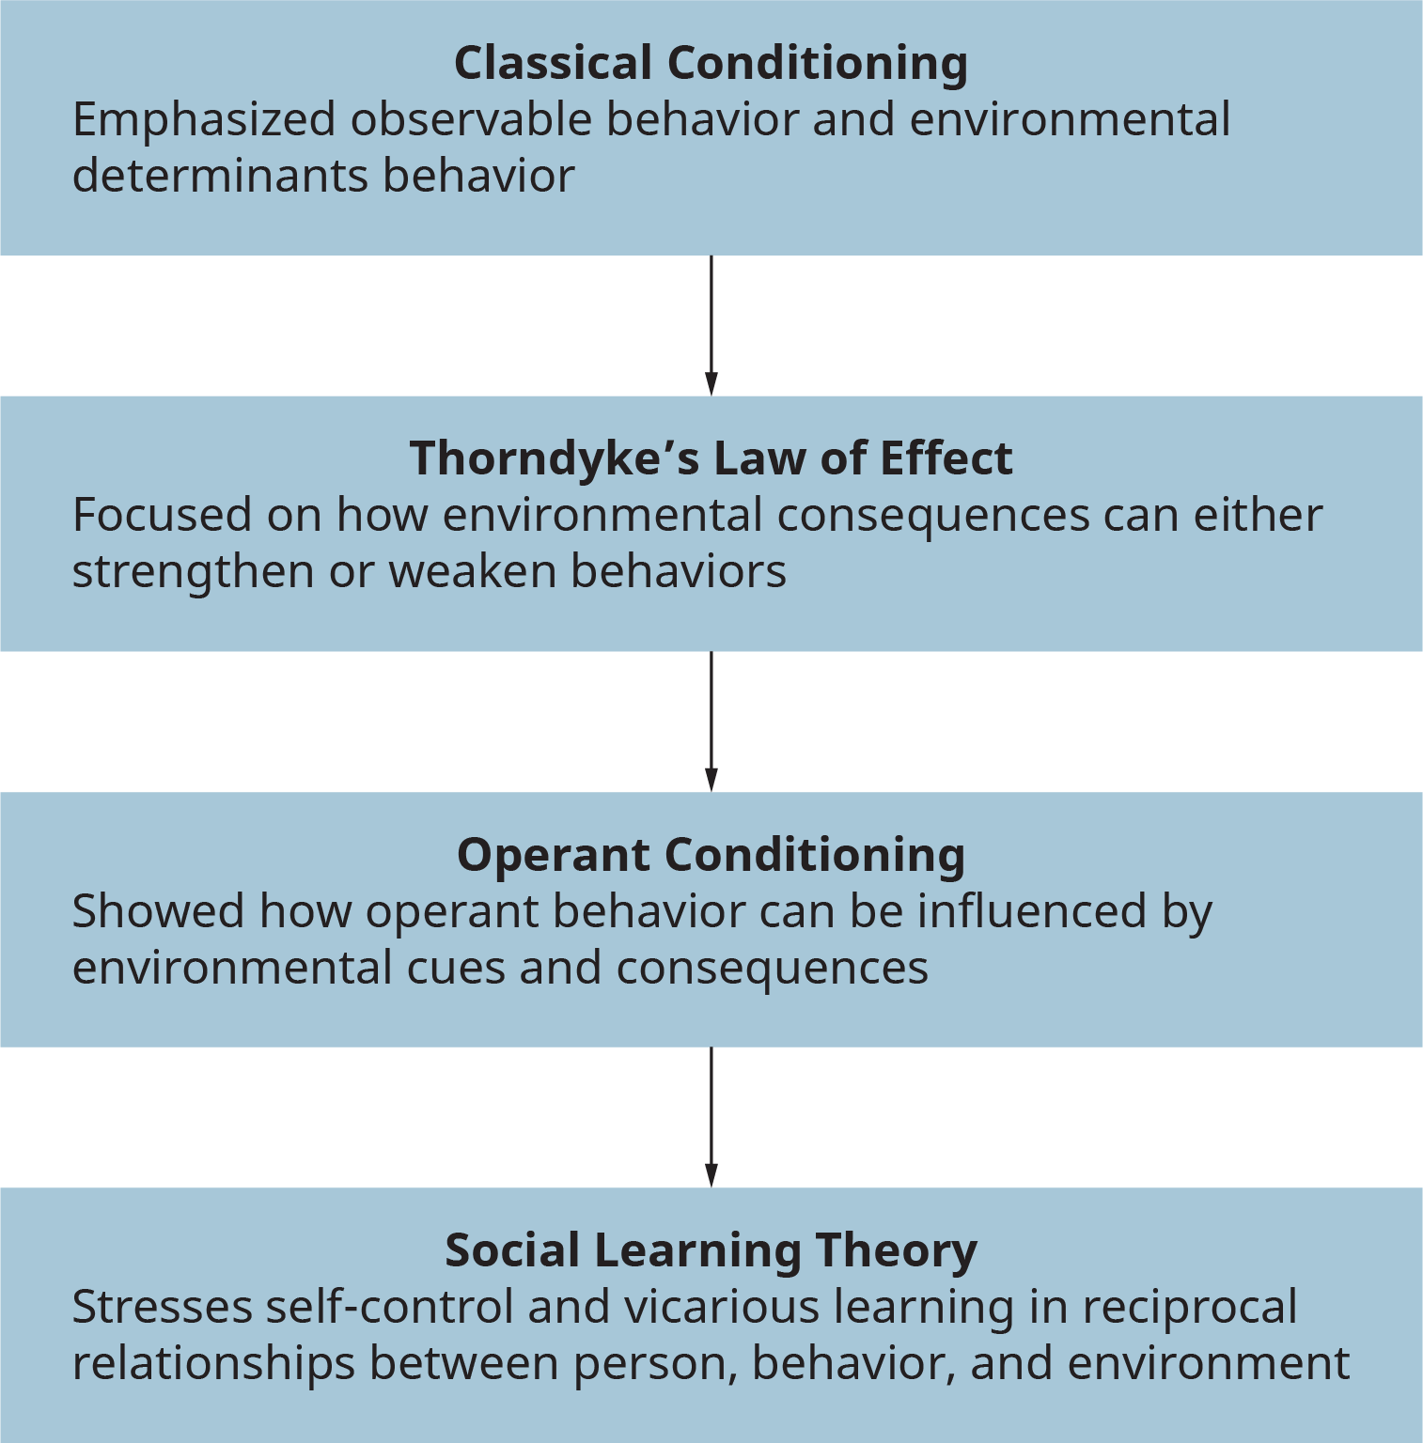
Exhibit 4.2 The Development of Modern Behavioral Learning Theory
(Attribution: Copyright Rice University, OpenStax, under CC-BY 4.0 license)

Slide 4
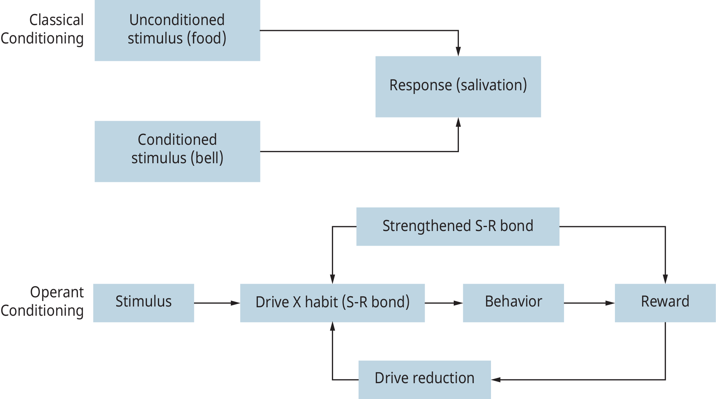
Exhibit 4.3 Classical versus Operant Conditioning
(Attribution: Copyright Rice University, OpenStax, under CC-BY 4.0 license)

Slide 5
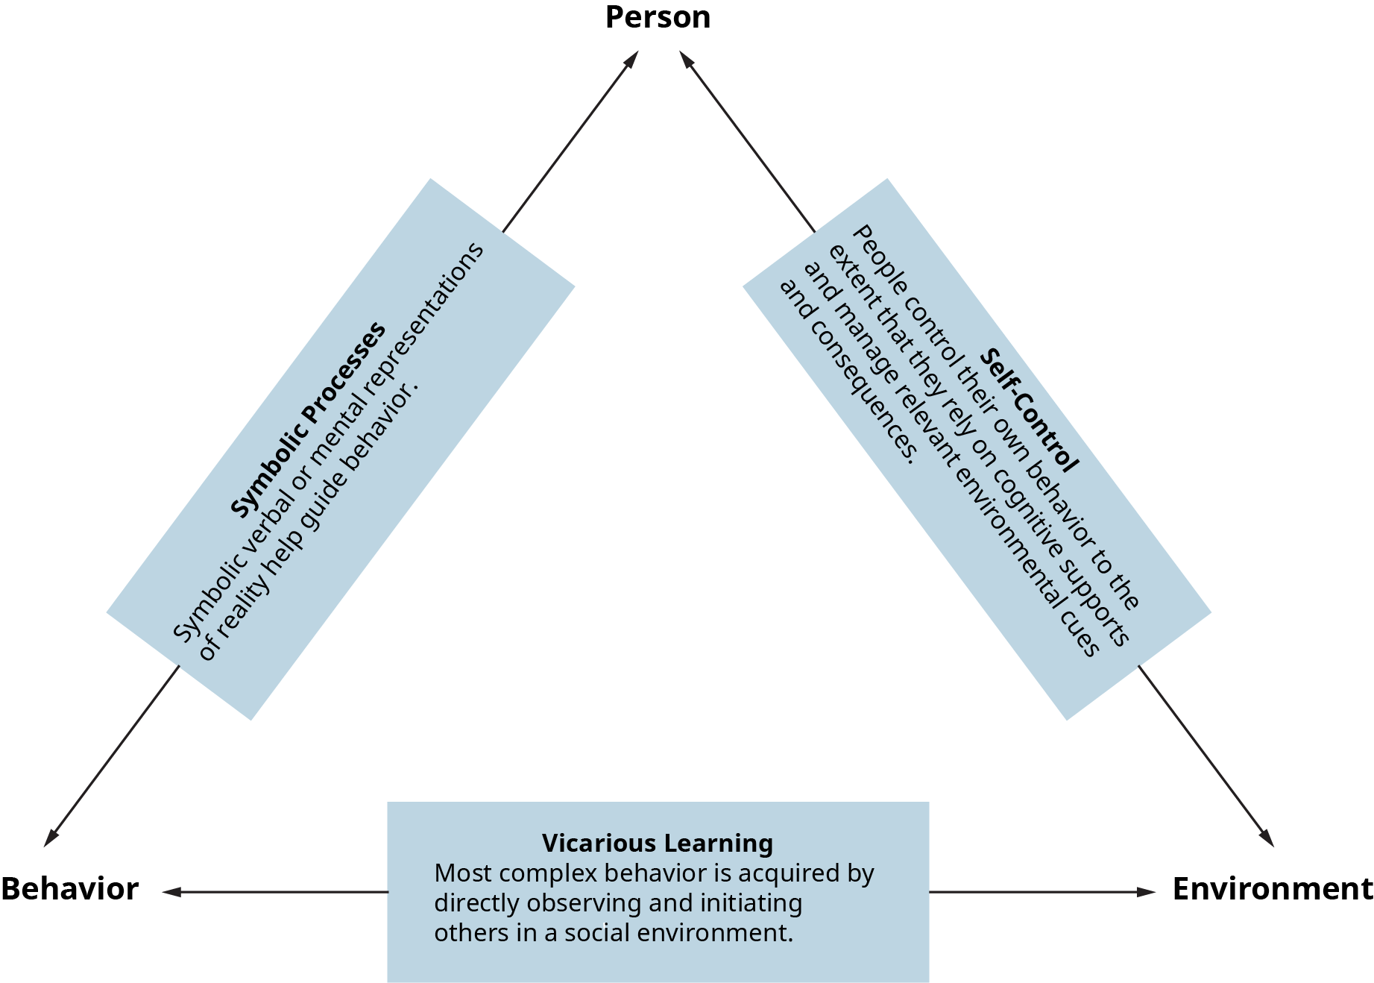
Exhibit 4-4 A Basic Model of Social Learning
(Attribution: Copyright Rice University, OpenStax, under CC-BY 4.0 license)

Slide 6
1. How do organizations offer appropriate rewards in a timely fashion?
Concept Check
How can learning theory be used to change behaviors?
Define classical conditioning, and differentiate it from operant conditioning.
What is social learning theory?

Slide 7
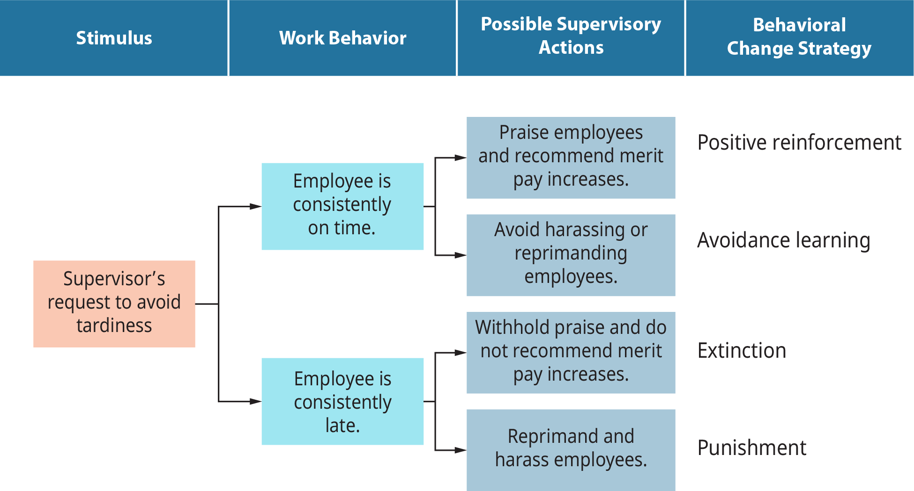
Exhibit 4.6 Strategies for Behavioral Change
(Attribution: Copyright Rice University, OpenStax, under CC-BY 4.0 license)

Slide 8
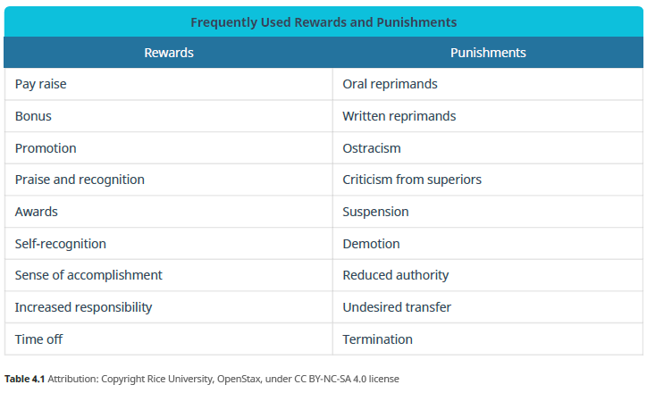
Table 4.1 Frequently Used Rewards and Punishments

Slide 9
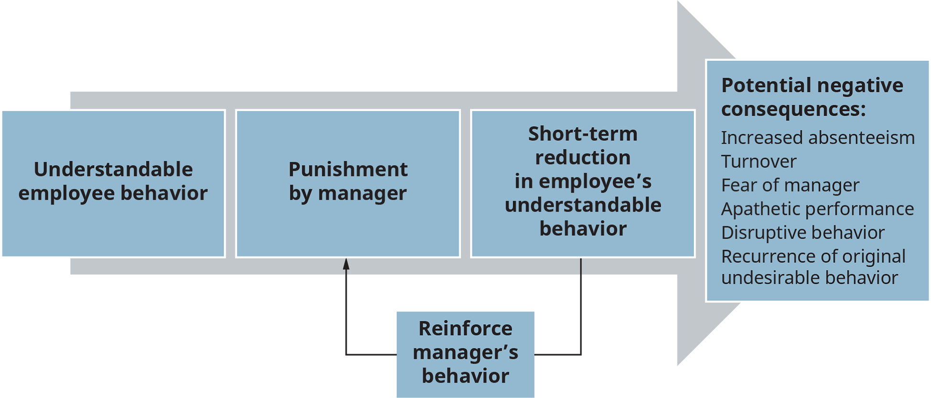
Exhibit 4.7 Potential Negative Consequences of Punishment
(Attribution: Copyright Rice University, OpenStax, under CC-BY 4.0 license)

Slide 10
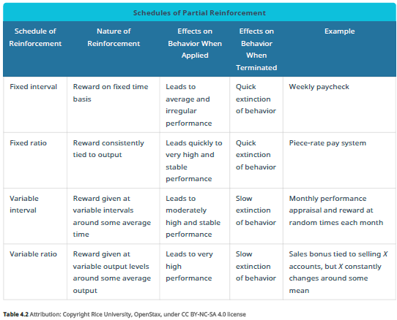
Exhibit 4.2 Schedules of Partial Reinforcement

Slide 11
2. What are the best practices that organizations utilize to train employees in new job skills?
Concept Check
What is reinforcement, and how can it be applied to motivation?
What are the four strategies to use for behavioral change?
What is the significance of schedules in changing behavior?

Slide 12
Exhibit 4.8 Steps in Implementing a Behavioral Modification Program
(Attribution: Copyright Rice University, OpenStax, under CC-BY 4.0 license)

Slide 13
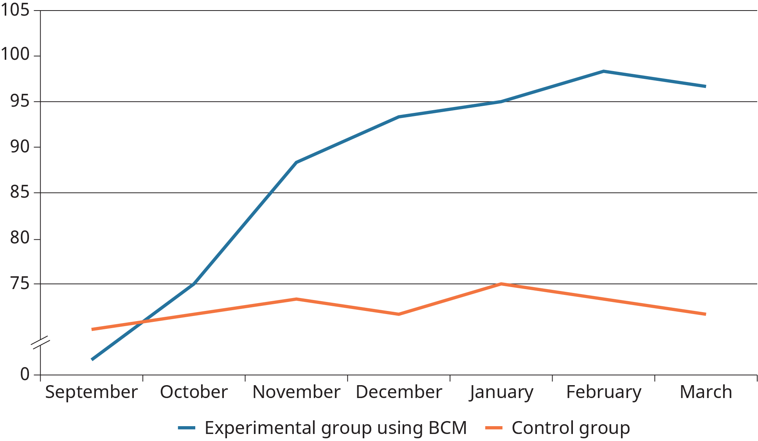
Exhibit 4.9 Intergroup Comparison of Performance Using BCM
(Attribution: Copyright Rice University, OpenStax, under CC-BY 4.0 license)

Slide 14
3. How do managers and organizations reduce undesirable employee behavior while reinforcing desirable behavior?
Concept Check
What is behavior modification?
What is a performance audit, and what are the components?

Slide 15
Exhibit 4.10 Kanfer’s Model of Self-Regulation
(Attribution: Copyright Rice University, OpenStax, under CC-BY 4.0 license)

Slide 16
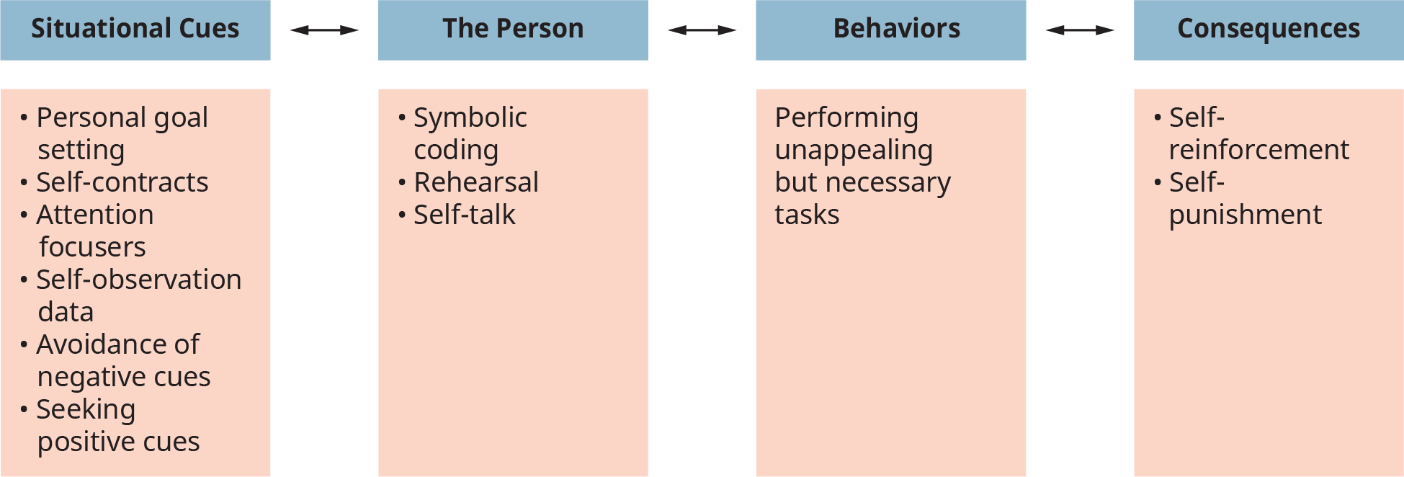
Exhibit 4.11 A Social Learning Theory Model of Self-Management
(Attribution: Copyright Rice University, OpenStax, under CC-BY 4.0 license)

Slide 17
4. How can employees be trained to assume more responsibility for self-improvement and job performance with the goal of creating a work environment characterized by continual self-learning and employee development?
Concept Check
Understand Kanfer’s behavioral self-management process.
What are things you can do to instill self-management techniques for yourself?
What behavioral self-management techniques can you use as a manager?
This OpenStax ancillary resource is © Rice University under a CC-BY 4.0 International license; it may be reproduced or modified but must be attributed to OpenStax, Rice University and any changes must be noted.

