Slide 1
Organizational Behavior
Chapter 19 ENTREPRENEURSHIP

Slide 2
Learning Outcomes
What are some different types of entrepreneurship?
What characteristics lead individuals to become entrepreneurs?
How can the business model canvas help us to describe and assess a business model?
How do entrepreneurs finance their new business ideas?
How can entrepreneurs leverage design thinking to solve complex problems and navigate uncertain environments?
How can government support entrepreneurship?

Slide 3
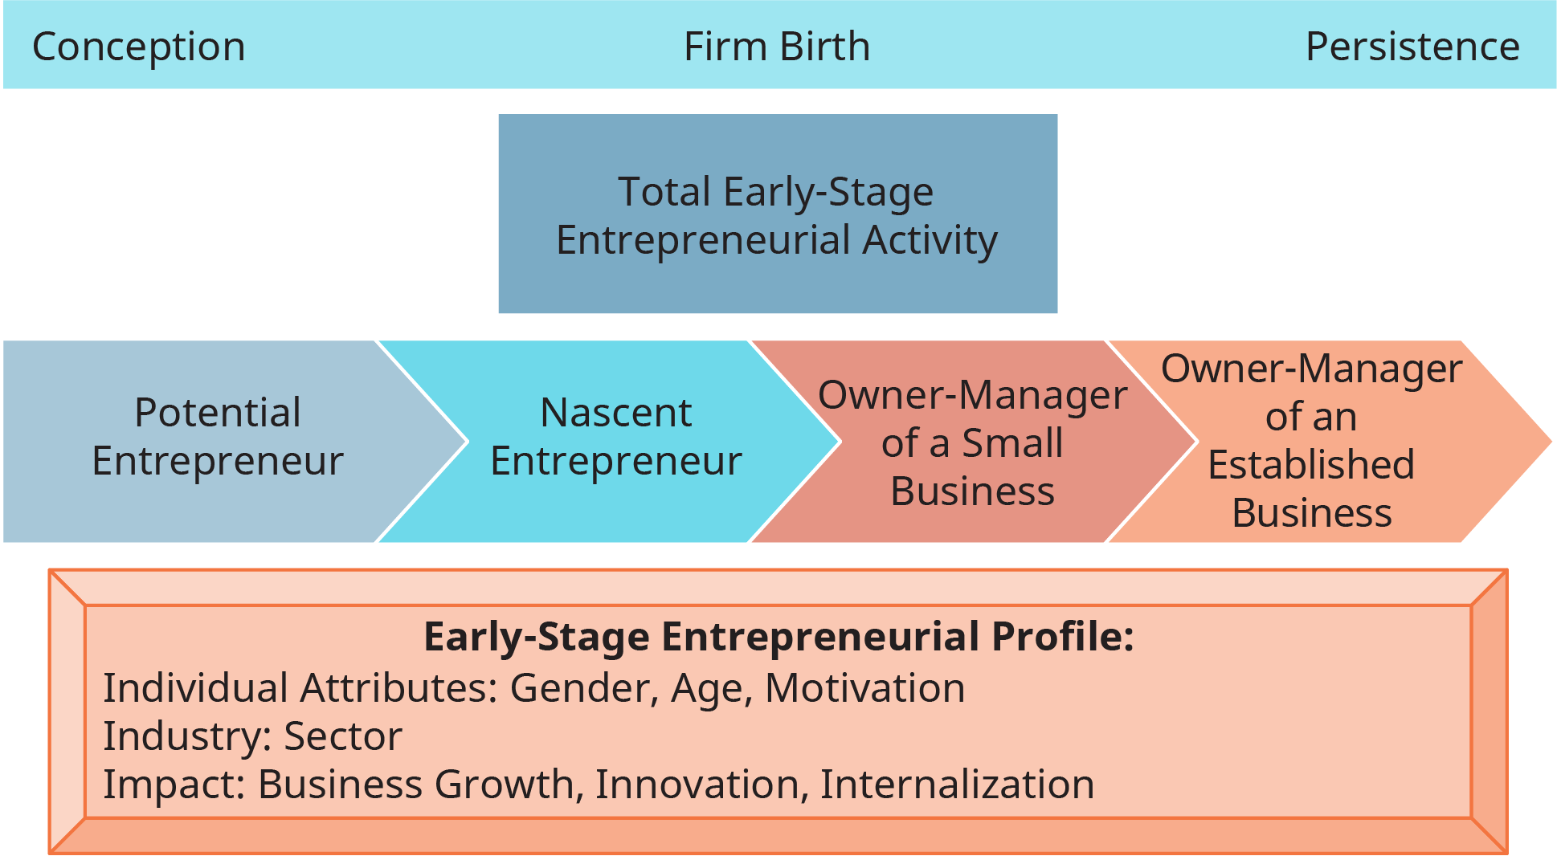
Exhibit 19.2 Model and Measures of Entrepreneurial Activity
Source: Adapted from Global Entrepreneurship Monitor 2017/2018 report, page 22 Attribution: Copyright Rice University, OpenStax, under CC BY-NC-SA 4.0 license

Slide 4
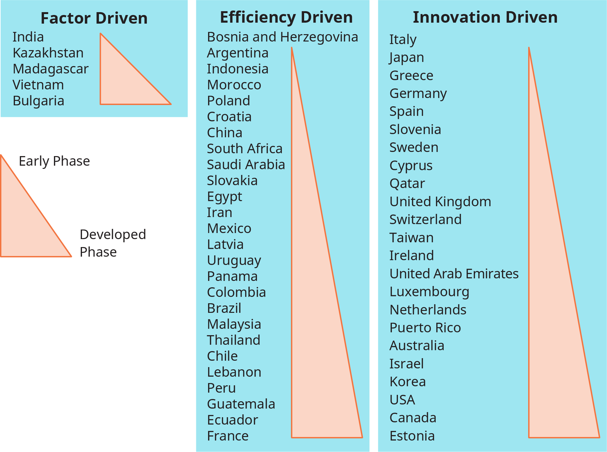
Exhibit 19.3 Entrepreneurial Activity in 2017-2018
Source: Adapted from Global Entrepreneurship Monitor 2017/2018 report, pages 34-35 Attribution: Copyright Rice University, OpenStax, under CC BY-NC-SA 4.0 license

Slide 5
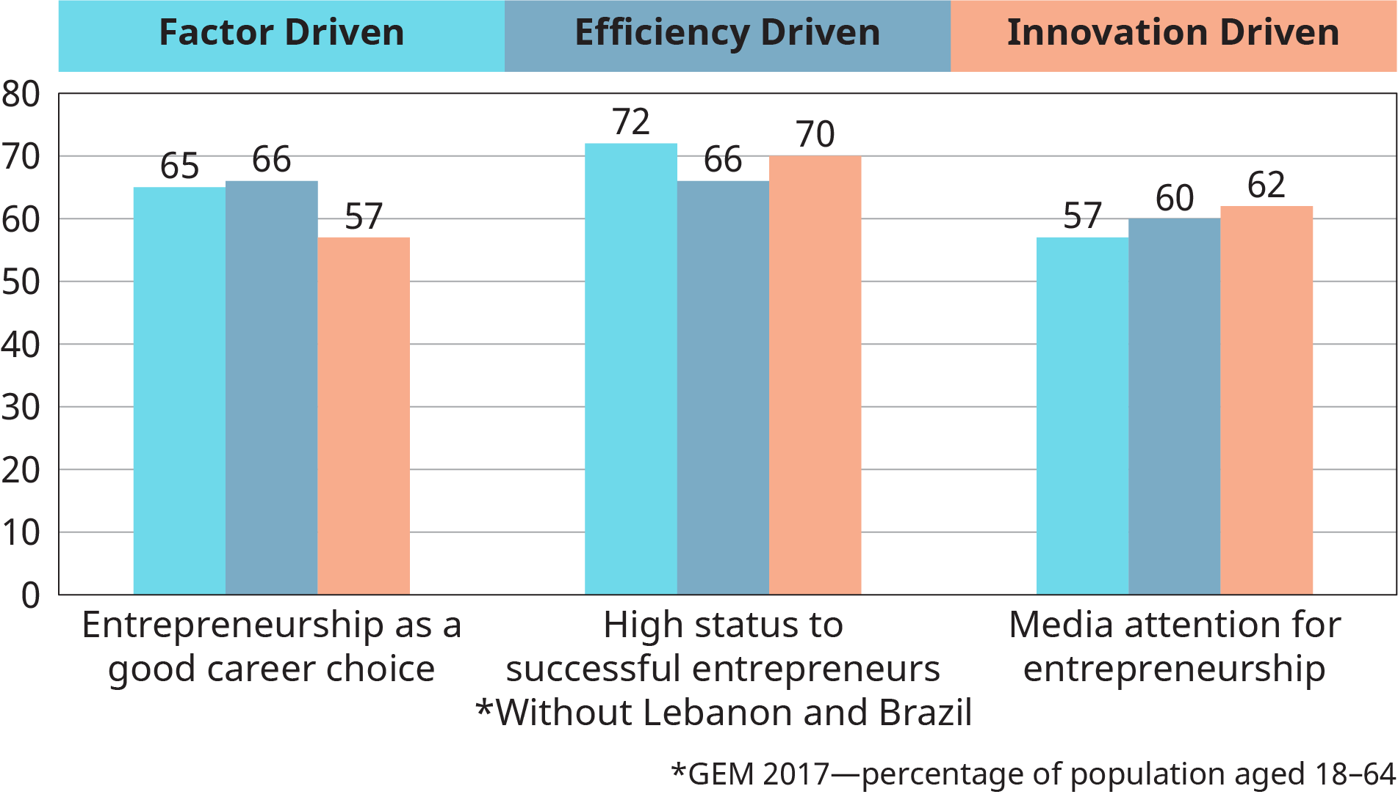
Exhibit 19.4 Developed Group Averages for Societal Values About Entrepreneurship
Source: Adapted from Global Entrepreneurship Monitor 2017/2018 report, page 27 Attribution: Copyright Rice University, OpenStax, under CC BY-NC-SA 4.0 license

Slide 6
1. What are some different types of entrepreneurship?
Concept Check
What are some different types of entrepreneurs?
How does entrepreneurship differ across countries?

Slide 7
2. What characteristics lead individuals to become entrepreneurs?
CONCEPT CHECK
Describe the personality traits and skills characteristic of successful entrepreneurs.
What does it mean when we say that an entrepreneur should work on the business, not in it?

Slide 8
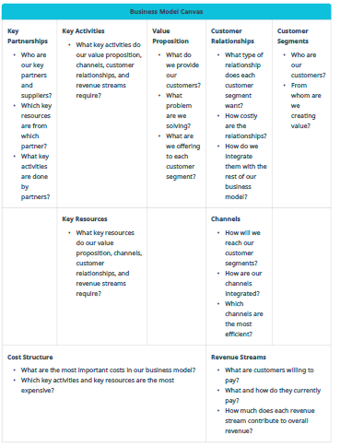
Table 19.1 Business Model Canvas
Attribution: Copyright Rice University, OpenStax, under CC BY-NC-SA 4.0 license

Slide 9
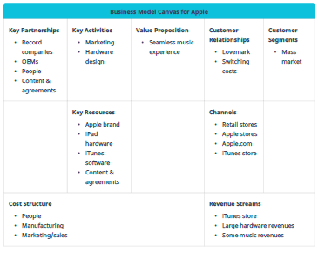
Table 19.2 Business Model Canvas for Apple
Attribution: Copyright Rice University, OpenStax, under CC BY-NC-SA 4.0 license

Slide 10
3. How can the business model canvas help us to describe and assess a business model?
CONCEPT CHECK
What are the key components of the business model canvas?
What are the advantages and disadvantages of being a first mover?

Slide 11
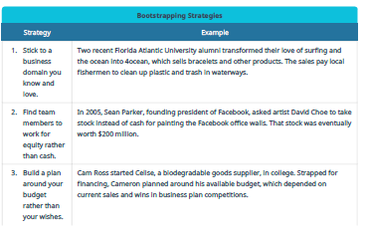
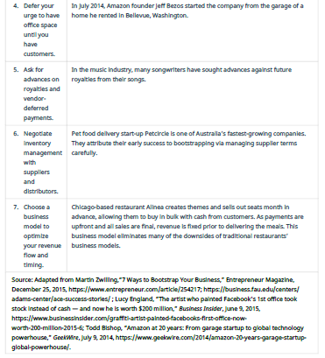
Table 19.3 Bootstrapping Strategies
Attribution: Copyright Rice University, OpenStax, under CC BY-NC-SA 4.0 license

Slide 12
4. How do entrepreneurs finance their new business ideas?
CONCEPT CHECK
How can potential business owners find new business ideas?
Why is it important to develop a business plan? What should such a plan include?
What financing options do small-business owners have? What risks do they face?

Slide 13
5. How can entrepreneurs leverage design thinking to solve complex problems and navigate uncertain environments?
CONCEPT CHECK
How does the small-business owner’s role change over time?
How does managing a small business contribute to its growth?
What are the benefits to small firms of doing business internationally, and what steps can small businesses take to explore their options?

Slide 14
6. How can government support entrepreneurship?
Concept Check
What are some things that managers can do to reduce stress in the organization?
This OpenStax ancillary resource is © Rice University under a CC-BY 4.0 International license; it may be reproduced or modified but must be attributed to OpenStax, Rice University and any changes must be noted.

